Slide 1
GaPSC Webcast Series
Certification Upgrades

Slide 2
GaPSC: Agency Introduction
MISSION STATEMENT:
“To build the best prepared, best qualified and most ethical educator workforce in the nation.”
“To build the best prepared, best qualified and most ethical educator workforce in the nation.”
CERTIFICATION
EDUCATOR PREPARATION
ETHICS
ASSESSMENT

Slide 3
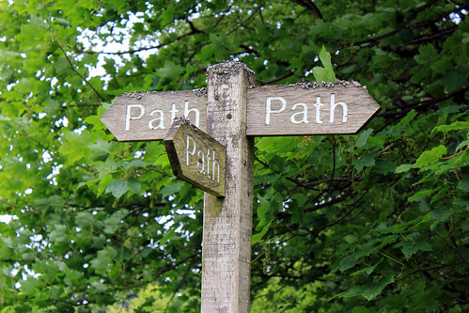
What should you expect in this session?
Degrees/certification areas which will result in certification upgrades
Types of upgrades
Programs that lead to certification
Requirements for certification upgrades
Tools for certification upgrades
How to apply for certification upgrades

Slide 4
What is upgrading?
The process of earning an advanced degree and raising the certificate level is called upgrading. The certificate level is part of the formula used to calculate placement on the state salary schedule.

Slide 5
Why upgrade?
An upgrade
provides evidence of additional knowledge in a field for which a candidate already holds certification
may result in additional career options
may result in elevation on the state salary schedule (pay increases are prescribed by the employing district)

Slide 6
What kinds of degrees result in upgrading?
Initial certification/preparation program – This program has been approved by the GaPSC during a peer review. After completion, the candidate/educator will receive certification in this area. This may be at any degree level.

Slide 7
What kinds of higher degrees result in upgrading?
Advanced program – This program will allow an educator to receive an infield upgrade on their certificate which will often result in a pay increase as determined by the state salary schedule. This program does not have to be approved by the GaPSC; however, it is accepted if it meets the qualifications for infield upgrades. An advanced/degree only program DOES NOT result in certification.

Slide 8
Which certificates can be upgraded?
Georgia educators holding a valid Induction, Professional, Advanced Professional, Lead Professional, Performance-Based, or Life Certificate at Level-4, -5 or -6, as long as they hold one of the following certificate types: Teaching (T), Service (S), or Leadership (L or PL).

Slide 9
Which certificates can not be upgraded?
Permits, Provisional certificates, International Exchange Certificates, and Paraprofessional Licenses.

Slide 10
What are the types of upgrades?
Infield – this allows an educator’s certificate to progress from one level to another (Level 4 -Baccalaureate, typically to a Level 5-Master’s, typically) in a field in which the educator already holds certification.

Slide 11
What fields allow for infield upgrading?
Educators may upgrade in any certification field applicable to certification upgrades even if they are not currently working in that field. These certification areas must be listed on the educator’s certificate and must be currently offered by the GaPSC. This may result in an increase in salary.

Slide 12
Is Educational Leadership different?
YES, in order for an educator who holds Educational Leadership certification to receive an upgrade and the potential increase in salary, s/he must be employed in a leadership position.

Slide 13
What are the types of upgrades?
New Field- This allows an educator to add an additional field to their certificate by completing all requirements for a program that has been approved for initial certification.

Slide 14
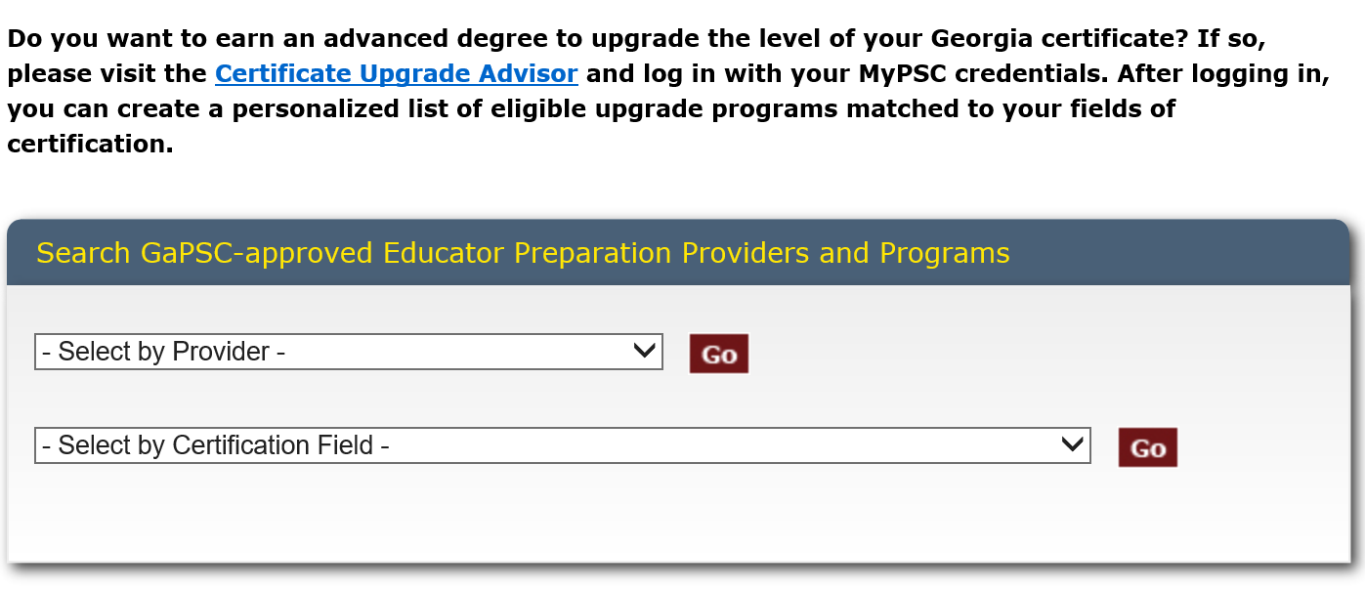
How can I find new field preparation programs that result in certification?
https://www.gapsc.com/EducatorPreparation/ApprovedPrograms/EducationApprovedPrograms.aspx

Slide 15
How do I know which provider offers my certification area at the appropriate level?

Slide 16
Can endorsements be upgraded?
Yes, as long as they are currently offered by the GaPSC. You may find the endorsements offered at
https://www.gapsc.com/Commission/Rules/Current/EducatorPreparation/EdPrepRules.aspx

Slide 17
What degrees would not result in an upgrade?
An advanced degree program used for an upgrade may not be one that leads to initial certification. For example, an educator who holds a level 4 certificate in Middle Grades Science based on completion of an approved bachelor’s degree program in that field may not upgrade his or her certificate by completing an M.A.T. program that would also lead to initial certification in Middle Grades Science.

Slide 18
What should I consider when seeking an upgrade?
Be sure the advanced degree that is of interest meets the requirements for certification upgrades:
Does it reflect my certification areas and is the degree from an approved/accepted provider?

Slide 19
What are the upgrade requirements?
 | Infield: Candidate’s field of certification (education or content) | New Field: New certification area in a GaPSC approved certification field
In State | Completion of program at a GaPSC approved education unit OR at a university with a Carnegie Classification of RU/VH Activity or RU/H Activity and add to certificate. | Completion of a GaPSC approved program that leads to initial certification at a GaPSC approved education unit AND pass the Georgia state approved content assessment AND complete Georgia requirements AND add the field to certificate.
Out of State | Completion of a program at an institution accredited by NCATE/TEAC/ CAEP OR at a university with a Carnegie Classification of RU/VH Activity or RU/H Activity | Completion of a state approved education program that leads to initial certification at a university either accredited by NCATE/ TEAC / CAEP OR with a Carnegie Classification of RU/VH Activity or RU/H Activity AND pass the Georgia state approved content assessment AND complete Georgia requirements AND add the field to certificate.
Op

Slide 20
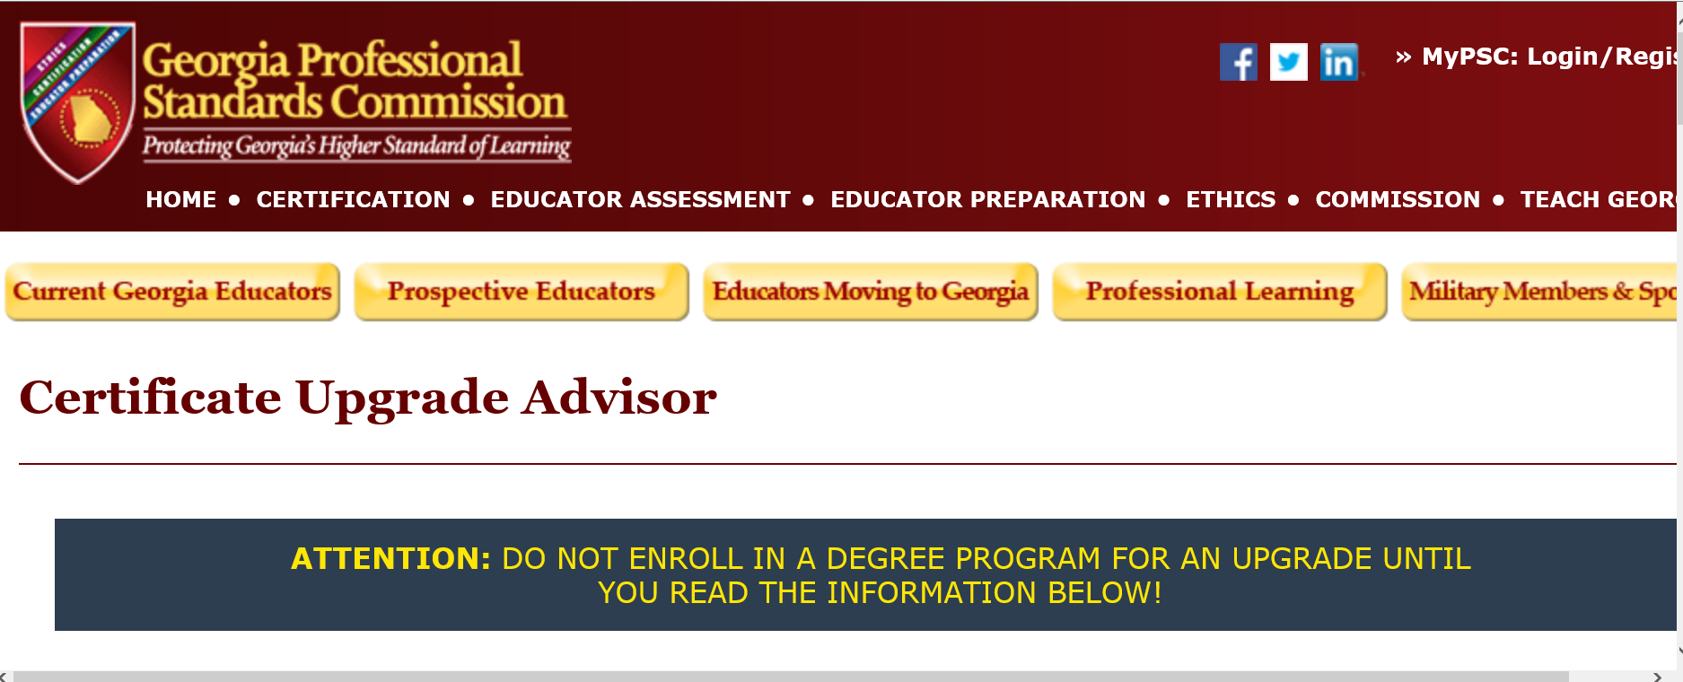
How do I make sure that the degree that interests me will meet the requirements?
https://www.gapsc.com/Commission/Policies_guidelines/UpgradeUtility/Upgrade_Initial.aspx

Slide 21
How can I find out if a degree will result in an upgrade?

Slide 22
What if I don’t find a degree that interests me in the Upgrade Advisor?
: https://www.gapsc.com/Certification/Downloads/Upgrade_Degree_Approval_Form.pdf?dt=DateTime.Now.Ticks.ToString()

Slide 23
How do I apply for an upgrade?
An educator applies for an upgrade through the “submit application/check status” tab of his/her MyPSC account. Transcripts cannot be uploaded through the account. The GaPSC requires official transcripts that are submitted directly by the provider or the employer.

Slide 24
What is your plan for upgrades?

