Slide 1
GaPSC Webcast Series
GACE Assessments Overview

Slide 2
Composite Scoring

Slide 3
What Are the Assessments?
Program Admission Assessment (PAA)
Educator Ethics Assessment
Content Assessment (Teaching, Service, and Leadership Fields)
Performance-based Assessments
Teacher Leadership
Educational Leadership
Paraprofessional Assessment

Slide 4
Program Admission Assessment (PAA)

Slide 5
Program Admission Assessment (PAA)
What is the purpose of the PAA?
To ensure potential educators have sufficient competency in reading, writing, and mathematics to be successful in a state-approved educator preparation program.
When is the PAA taken?
The PAA must be passed or exempted to enter a state-approved educator preparation program.
For some situations, the PAA is required for state certification.
.

Slide 6
Program Admission Assessment (PAA)
Exemption
Pass Each Test (250)
Composite Score (750)
Limited Flexibility
SAT
ACT
GRE
Math (250)
Reading (250)
Writing (250)
Combination of all three scores totals 750 or higher
Provides flexibility for EPPs for a limited number of candidates
EPP Decision
.

Slide 7
Educator Ethics Assessment

Slide 8
Educator Ethics Assessment
What is the purpose of the ethics assessment?
To ensure potential educators know, understand, and apply Georgia’s Code of Ethics for Educators, as well as comprehend and embrace the principles of ethical decision-making in an educational context.
When is the ethics assessment taken?
The ethics assessment must be passed to enter a state-approved educator preparation program.
.

Slide 9
Georgia Educator
Ethics Assessment

Slide 10
Educator Ethics Assessment
What do the instructional modules cover?
Module 1: The Professional Educator: The Trailer
Module 2: The Professional Educator: An Introduction
Module 3: The Professional Educator and the Student
Module 4: The Professional Educator and the School
Module 5: The Professional Educator and the Community
Module 6: Ethical Decision Making for the Professional Educator
Module 7: The Professional Educator in Georgia (for teachers), or Leading the Professional Educator in Georgia (for leaders)
.

Slide 11
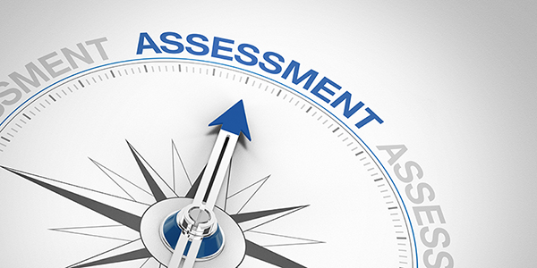
Content Assessments

Slide 12
Content Assessment
What is the purpose of the content assessment?
To ensure educator candidates have sufficient content knowledge and skills in their area(s) of certification.
When is the content assessment taken?
Traditional Programs: Must be attempted prior to completion of a state-approved educator preparation
Non-traditional Programs: Must be passed prior to entering a GaTAPP educator preparation program.

Slide 13
Content Assessment
There are 49 separate GACE assessments in teaching, service, and leadership fields.
Assessments consist of either one or two tests and contain selected-response questions, and, in some cases, one or more constructed-response (written, spoken, or signed) assignments.
The GACE assessments are available nationally and internationally.

Slide 14
Performance-based Assessments

Slide 15
Teacher Leadership (TL) Assessment
What is the purpose of the TL assessment?
The TL assessment assesses the critical leadership roles that teachers play in contributing to student and school success.
When is the TL assessment taken?
The TL assessment must be attempted prior to completion of a state-approved TL educator preparation program and passed for certification.
.

Slide 16
Teacher Leadership Assessment
What performance tasks are included in the assessment?
Task 1: Adult Learning and the Collaborative Culture
Task 2: Research for the Improvement of Practice
Task 3: Professional Learning
Task 4: Observation and Use of Assessment Data
Task 5: Collaboration with Families and Community
Task 6: Collaborative Teams and Advocacy
.

Slide 17
Performance Assessment for School Leaders (PASL)
What is the purpose of the PASL?
The PASL assesses the critical roles of educational leaders in contributing to student and school success.
When is the PASL taken?
The PASL assessment must be attempted prior to completion of a state-approved Tier II Educational Leadership educator preparation program and passed for certification.
.

Slide 18
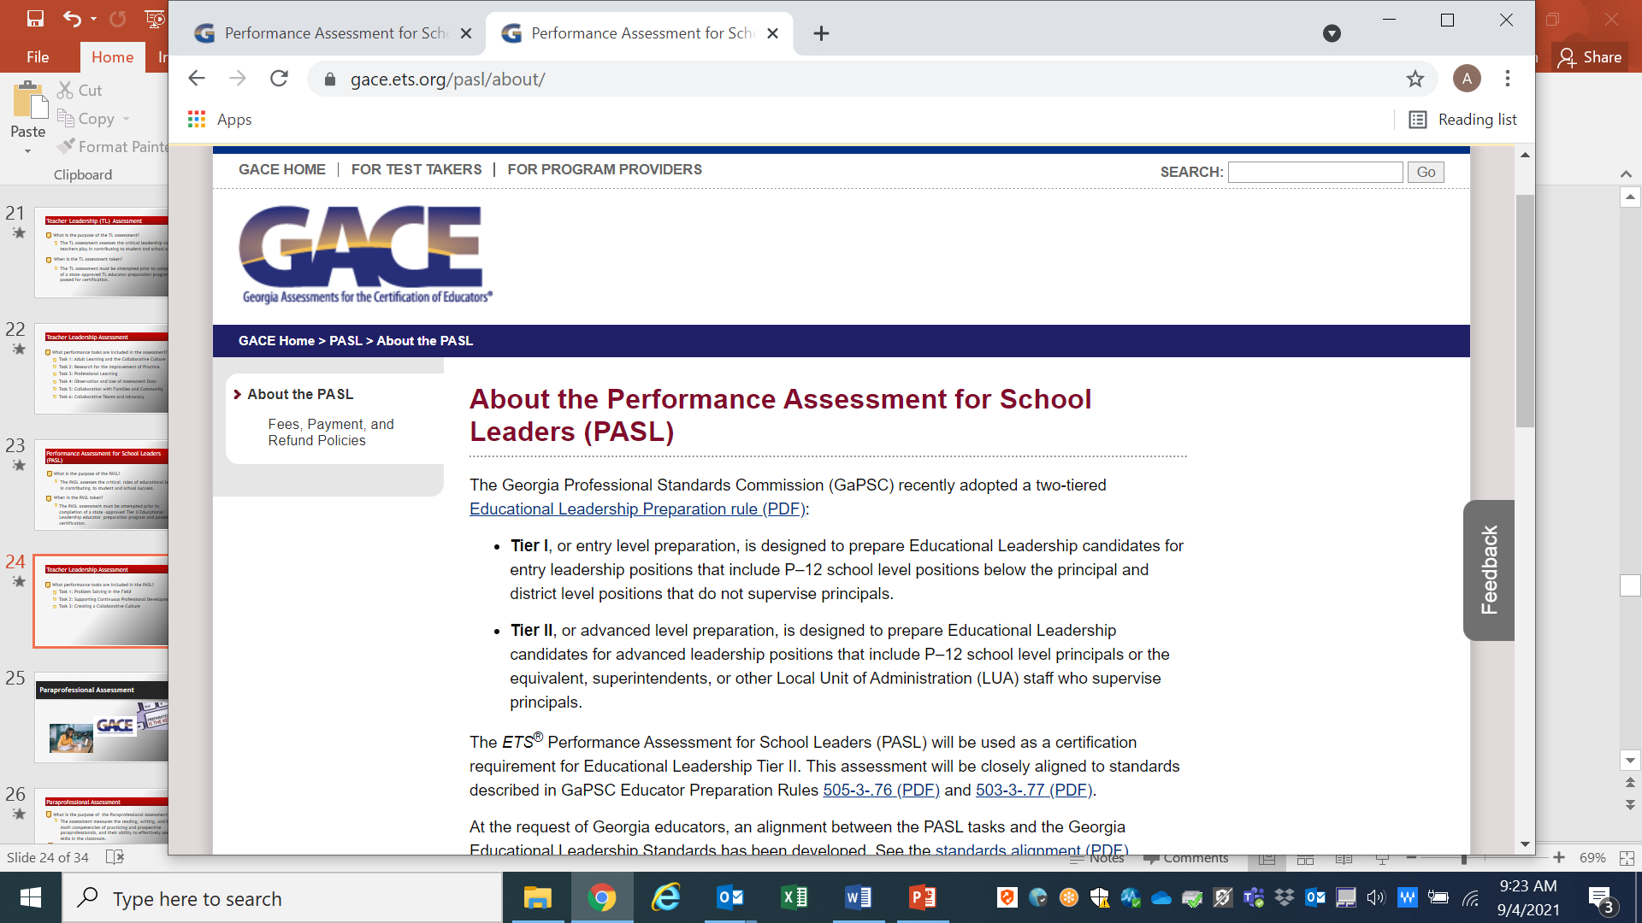
PASL Assessment
What performance tasks are included in the PASL?
Task 1: Problem Solving in the Field
Task 2: Supporting Continuous Professional Development
Task 3: Creating a Collaborative Culture
.

Slide 19
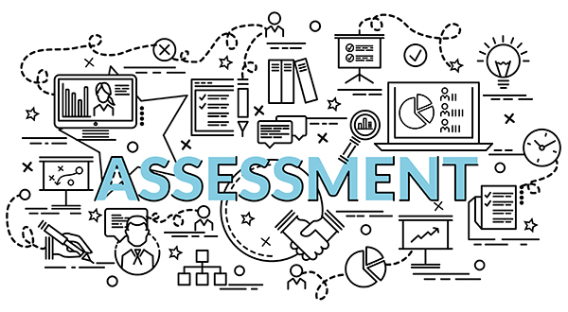
Paraprofessional Assessment

Slide 20
Paraprofessional Assessment
What is the purpose of the Paraprofessional Assessment?
The assessment measures the reading, writing, and basic math competencies of practicing and prospective paraprofessionals, and their ability to effectively use those skills in the classroom.
When is the Paraprofessional Assessment taken?
The assessment must be passed for state-certification as a paraprofessional, except for those who exempt it.
.

Slide 21
Paraprofessional Assessment
What is the purpose of the Paraprofessional Assessment?
The assessment measures the reading, writing, and basic math competencies of practicing and prospective paraprofessionals, and their ability to effectively use those skills in the classroom.
When is the Paraprofessional Assessment taken?
The assessment must be passed for state-certification as a paraprofessional, except for those who exempt it.
.

Slide 22
Paraprofessional Assessment
There are two ways to exempt the Paraprofessional Assessment testing requirement:
Hold an associate’s degree or higher in any subject from a GaPSC-accepted accredited institution; or
Have completed two (2) years of college coursework (sixty [60] semester hours) above the remedial level with a grade of “C” or better at a GaPSC-accepted accredited institution.
Those who must take the Paraprofessional Assessment must also hold a minimum of a high school diploma or GED equivalent.
.

Slide 23
Preparation Resources
https://www.gace.ets.org/prepare/

Slide 24
Preparation Resources
Preparation Resources for every assessment are available on the GACE website at https://www.gace.ets.org
Study Companions
Test Frameworks and Objectives
Tests at a Glance
Interactive Practice Tests
Tutorials
Videos and Webinars
And More
.

Slide 25
Registration Information
https://www.gace.ets.org/register/steps

Slide 26
Registration Steps
Before you register:
Identify which assessment you wish to take
Obtain approval from your program provider
Review Registration Bulletin
Read Rules of Test Participation
Choose a test center and date
See “Getting Ready to Test”
https://www.gace.ets.org
.

Slide 27
Registration Steps
Create a MyPSC account at https://mypsc.gapsc.org/Login.aspx
Create an ETS testing account at mygace.ets.org
Information about disability accommodations, including how to request accommodations and register, is available on the GACE website.
Please consult the GACE website, including the Registration Quick Reference Guide, for complete registration information.
.

Slide 28
Need Assistance?
The GACE website is the best source of information. If additional assistance is needed, please email: gace_inquiries@ets.org
https://www.gace.ets.org

Slide 29
GaPSC Webcast Series
GACE Assessments Overview

