Slide 1
GaPSC Webcast Series
Educator Assessment

Slide 2
GaPSC: Agency Introduction
MISSION STATEMENT:
“To build the best prepared, best qualified and most ethical educator workforce in the nation.”
“To build the best prepared, best qualified and most ethical educator workforce in the nation.”
CERTIFICATION
EDUCATOR PREPARATION
ETHICS
ASSESSMENT

Slide 3
Why Have Educator Assessments?
Purpose
To ensure educators have the knowledge and skills to perform the job of an educator in Georgia's public schools.
Informs an educator’s practice as to strengths and areas for growth
Informs preparation program providers as to program effectiveness
Informs employing districts and schools as to areas of needed support
Provides assurance to the public that educators are equipped to be successful with their learners

Slide 4
Composite Scoring

Slide 5
Who Develops Each GACE?
Georgia P-12 educators who are certified in the assessment area
Georgia preparation program providers who prepare educators in the assessment area
Other Georgia educational stakeholders depending on the assessment

Slide 6
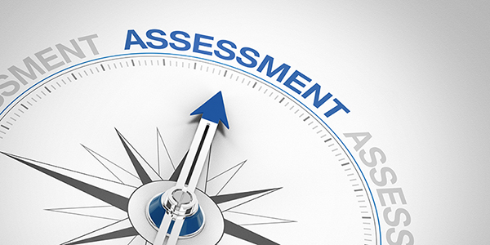
How is each GACE developed?
Test Development Committee
Bias Review Committee
Standard Setting Committee

Slide 7
Program Admission Assessment (PAA)

Slide 8
Educator Ethics Assessment

Slide 9
Content Assessments

Slide 10
Performance-based Assessments

Slide 11
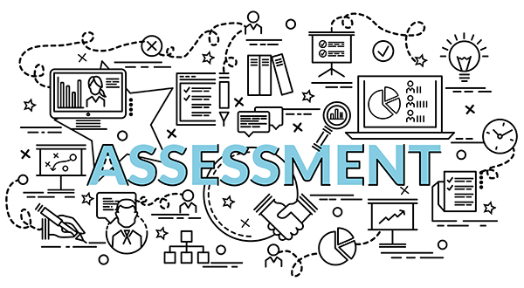
Paraprofessional Assessment

Slide 12
Preparation Resources

Slide 13
Preparation Resources
Preparation Resources for every assessment are available on the GACE website at https://www.gace.ets.org.
Study Companions
Test Frameworks and Objectives
Tests at a Glance
Interactive Practice Tests
Tutorials
Videos and Webinars
And More
.

Slide 14
Need Assistance?
The GACE website is the best source of information. If additional assistance is needed, please email: gace_inquiries@ets.org.
https://www.gace.ets.org

Slide 15
GaPSC Webcast Series
Educator Assessment

