Slide 1


Avoiding Ethical Missteps
GaPSC Code of Ethics
2024-2025 Presentation

Slide 2

Learning Intentions
I am learning more about
Georgia’s Code of Ethics for Educators.
I am learning how to ensure safe learning environments for Georgia’s students.
I am learning about why enhanced knowledge and application of ethical practice is important.
I am learning how to avoid ethical missteps.
I am learning how to protect myself, colleagues, school, community, profession, and most importantly students.

Slide 3

Success Criteria
I can give the definitions of the standards in Georgia’s Code of Ethics for Educators.
1
I can determine what are and are not violations of the Code of Ethics.
2
I can give examples of appropriate and inappropriate conduct.
3
I can provide reasons why making ethical decisions is important.
4

Slide 4

Agenda
About the Georgia Professional Standards Commission
About the
Georgia Code
of Ethics
for Educators
Unpacking the
Standards
- Common Violations
- Scenarios
- Takeaways
Prevention
Resources
The Need

Slide 5

Georgia Professional Standards Commission Timeline
1991
Created by Statute
.
1994
Educator Testing Added
1998
Educator Ethics Added
2001
Recruitment functions added

Slide 6
About the GaPSC
“ To build the best prepared, best qualified and most ethical educator workforce in the nation”
“Protecting Georgia’s Higher Standard of Learning”
Mission Statement
Vision Statement

Slide 7
GaPSC Responsibility
Georgia Code:
§ 20-2-981.1.
The standards of performance and code of ethics adopted by the Commission shall be limited to professional performance and professional ethics… which does not include one’s personal life as long as it does not impact one’s professional life.
It shall be the duty of the Commission to adopt standards of performance and a code of ethics for educators… which are generally accepted by educators of this state.

Slide 8
About the Commission
18 total members from across Georgia that are Governor-appointed for three year terms.
9 Teachers, 1 from a private school
2 Administrators
2 School Board members
2 Higher Education Program Providers (1 public; 1 private)
3 Private Sector Representatives

Slide 9
About the Commission
Educator Preparation/Certification Committee
Educator Ethics Review Committee
9 members
Review new complaints monthly
Determine sanction recommendations based on investigative findings
  9 members
  Ensures that Educator Preparation Providers are meeting the designated standards and program approval procedures

Slide 10

Guidelines, Policy, and Law
Local Level
District or School Guidance and Policy
State Policy
Georgia Code of
Ethics for Educators
State Law
Official Code of Georgia (O.C.G.A), including Mandated Reporter Law
Federal Law
Including Family Educational Rights and Privacy Act (FERPA)

Slide 11

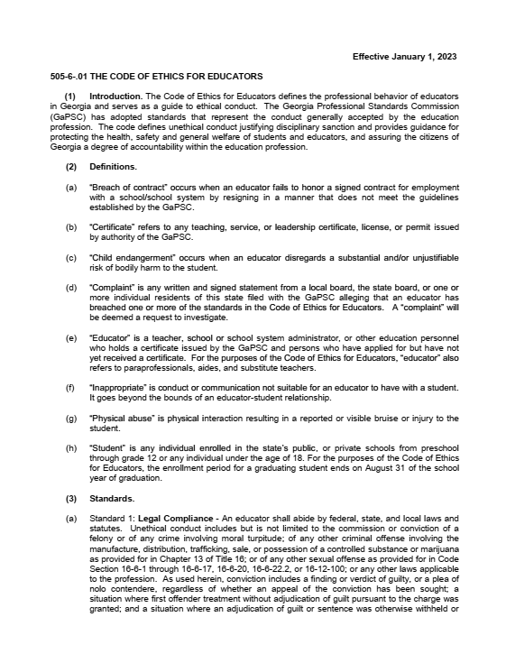
The Georgia Code of Ethics
for Educators
Defines the professional behavior of educators in Georgia and serves as a guide to ethical conduct.
Contains 10 standards that represent the conduct generally accepted by the education profession.
Defines unethical conduct justifying disciplinary sanction and provides guidance for protecting the health, safety, and general welfare of students and educators, and assures the citizens of Georgia a degree of accountability within the education profession.

Slide 12


The Need

Slide 13
Why Focus on Avoiding Missteps?
Great damage can be done to children, colleagues, schools, communities, and the profession by unethical acts of educators.
In Georgia, the Commission sanctions, suspends, or revokes the certificates of talented educators each month due to violations of the Georgia Code of Ethics for Educator.
During academic year 2024, there were 2,337 ethics cases opened on Georgia educators. This is a 29% increase from the last year.
The GaPSC believes that these cases are preventable.
The GaPSC is highly committed to an ethical educator workforce, and this training is a part of our proactive approach to ethics education, outreach and prevention.

Slide 14

About the Georgia Code of Ethics for Educators
Standards 1 - 10

Slide 15

COE Operational Definitions
“Educator” is any teacher, school or school system administrator, or other education personnel who holds a certificate issued by the GaPSC and persons who have applied for but have not yet received a certificate.
For the purposes of the Code of Ethics for Educators, “educator” also refers to paraprofessionals, aides, and substitute teachers.
  GaPSC Rule 505-6-.01 (2)(d)

Slide 16

COE Operational Definitions
“Student” is anyone under the age of 18 OR a student enrolled in grades Pre-K to 12 in a public or private school.
For the purposes of the Code of Ethics, the enrollment period for a graduating student ends on August 31 of the year of graduation.

Slide 17


Student or Not?
The student graduated in May of that school year. Over the summer, the educator received a text from the student asking for advice about a personal issue and asked to meet on a Saturday at the local coffee shop. As the student had graduated, the teacher decided to meet with the student.
Is the individual still considered a student?

Slide 18
Code of Ethics for Educators Standards
Standard 1: Legal Compliance
Abide by all federal, state, and local laws and statutes.
Standard 2: Conduct With Students
Maintain a professional relationship with all students, both in and outside the classroom.
Standard 3: Alcohol and Drugs
Refrain from the use of alcohol or illegal or unauthorized drugs during the course of professional practice.
Standard 4: Honesty
Exemplify honesty and integrity in the course of professional practice.

Slide 19
Code of Ethics for Educators Standards
Standard 5: Public Funds & Property
An educator entrusted with public funds and property shall honor that trust with a high level of honesty, accuracy, and responsibility.
Standard 6: Remuneration
Maintain integrity with students, colleagues, parents, patrons, or businesses when accepting gifts, gratuities, favors, and additional compensation.
Standard 7: Confidential Information
Comply with state and federal laws and state school board policies relating to the confidentiality of student and personnel records, standardized test material, and other information.

Slide 20
Code of Ethics for Educators Standards
Standard 8: Required Reports
Report a breach of one or more of the standards in the Code of Ethics for Educators, child abuse (O.C.G.A. §19-7-5), or any other required report.
Standard 9: Professional Conduct
Demonstrate conduct that follows generally recognized professional standards and preserves the dignity and integrity of the education profession.
Standard 10: Testing
Administer state-mandated assessments fairly and ethically.

Slide 21

Georgia Code of Ethics
for Educators
Standard 1:
Legal Compliance

Slide 22
Standard 1: Legal Compliance
Unethical conduct includes but is not limited to the commission or conviction of:
Any felony.
Any misdemeanor crime involving moral turpitude.
Any criminal offense involving a controlled substance or marijuana.
Any sexual offense specified in Code Section 16.
Any law applicable to the profession.
An educator shall abide by federal, state, and local laws and statutes.

Slide 23

Moral Turpitude Explained
In its legal sense, it includes everything contrary to justice, honesty, modesty, or good morals.
All felonies and any misdemeanor involving moral turpitude have to be reported.
See the moral turpitude document available at: https://www.gapsc.com/Ethics/MoralTurpitude.aspx

Slide 24
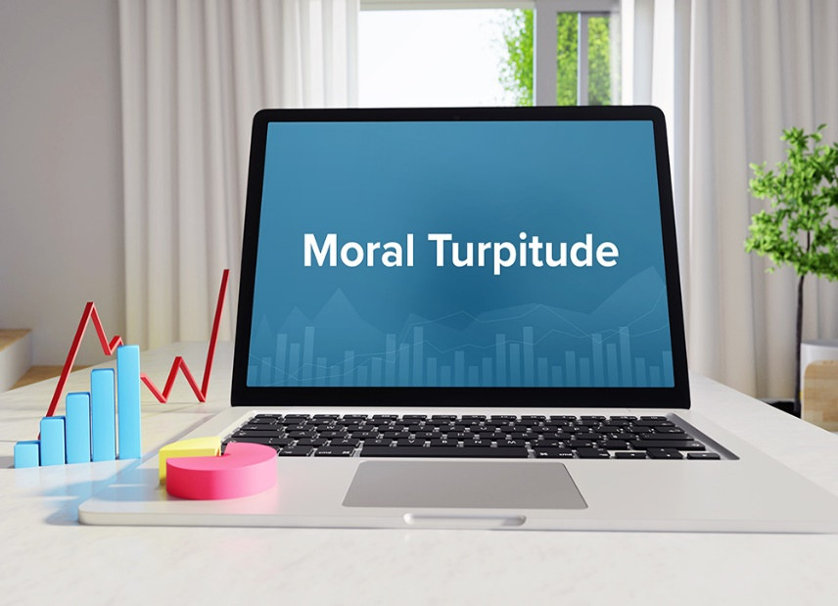
Examples of Moral Turpitude Offenses
The following offenses, or similar offenses, are crimes involving moral turpitude:
Fraud or false pretenses in obtaining something of value;
Larceny (includes shoplifting);
Misdemeanor theft by taking;
Larceny after trust;
Murder;
Soliciting for prostitutes;
Voluntary manslaughter;
Sale of narcotics or other illegal drugs;
Pattern of failure to file federal tax returns in years that taxes are due;
Criminal Issuance of a bad check;
Making a false report of a crime;
Sexual Battery; and
Providing contraband to an inmate.

Slide 25
Offenses NOT Considered Moral Turpitude
Public drunkenness;
Driving under the influence;
Carrying a concealed weapon;
Unlawful sale of liquor;
Fighting;
Simple Battery;
Simple Assault;
Misdemeanor criminal trespass;
Child abandonment;
Misdemeanor offense of escape;
Misdemeanor offense of obstructing a law enforcement officer;
The federal misdemeanor offense of Conspiracy in Restraint of Interstate Trade and Commerce; and
Possession of less than one ounce of marijuana.

Slide 26

Standard 1: Common Violations
Not disclosing minor charges on Personal Affirmation Questions (PAQs) in MyPSC Accounts, including shoplifting, misdemeanor marijuana, etc.
Having criminal history prior to or while certified.

Slide 27

Standard 1: Scenario
In 2004, the educator was arrested for misdemeanor theft by taking. The educator was convicted, paid $139 fine and served 12 months of probation. Several months later, the educator was arrested for misdemeanor theft by shoplifting. The educator pled guilty and received a 12 month suspended sentence. In July 2023, the educator answered “Yes” to affirmation question #7. The application was the first notice to the PSC regarding his arrests and convictions. The educator was previously certified as a paraprofessional.
The educator violated Standard 1 (Misdemeanor Crime of Moral Turpitude) and Standard 8 (Required Reports) by failing to disclose the convictions earlier.

Slide 28
Standard 1: Scenario
The educator, an elementary school teacher, self-reported a vandalism charge pending against her in Tennessee. The charge stemmed from a domestic incident that occurred in 2022. She went to Tennessee and answered the charge. The case was dismissed and expunged when the judge learned the other party, provided false information to get her arrested. A court and police records check verified the records were expunged.
This is not a Standard 1: Legal Compliance violation.

Slide 29

Standard 1: Scenario
The educator, a middle school teacher, was arrested and charged with possession of marijuana and cocaine. The educator admitted to the facts outlined in the incident report, which included that he was smoking marijuana in a parking lot, and that he possessed small clear baggies which once had cocaine in them. He admitted to using cocaine right before being arrested. Educator admitted to having mental health problems that led him to cope by using marijuana and cocaine over the last year.
Although educator was remorseful and seeking help, Standard 1 was violated and educator was suspended.

Slide 30

Standard 1: Takeaways
Follow the law.
Read all applications carefully and adhere to the application requirements.
Anyone who holds an educator certification/license must disclose a controlled substance conviction within 10 days to the GaPSC. (O.C.G.A § 16-13-111).
  Failure to do so, may result in automatic revocation of certification/license.

Slide 31
Standard 1: Takeaways (continued)
No matter how old an offense, attest to it when completing Personal Affirmation Questions (PAQs), applications, etc. It is critical to answer YES appropriately as to if there has been a conviction. YES answers are investigated under Standard 1: Legal Compliance. Not answering PAQs truthfully also violates Standard 4.
Conduct/ethics sanctions in another state must be self-reported to the GaPSC and/or disclosed on PAQs where appropriate.
Failure to respond to the GaPSC requests for more information results in a revocation.

Slide 32

Georgia Code of Ethics
for Educators
Standard 2:
Conduct with Students

Slide 33
Standard 2: Conduct with Students
Unethical conduct includes but is not limited to:
committing any act of child abuse, including physical and verbal abuse;
committing any act of cruelty to children or any act of child endangerment;
committing any sexual act with a student or soliciting such from a student;
engaging in or permitting harassment of or misconduct toward a student that would violate a state or federal law;
soliciting, encouraging, or consummating an inappropriate written, verbal, electronic, or physical relationship with a student;
furnishing tobacco, alcohol, or illegal/unauthorized drugs to any student; or
failing to prevent the use of alcohol or illegal or unauthorized drugs by students under the educator’s supervision (including but not limited to at the educator’s residence or any other private setting).
An educator shall always maintain a professional relationship with all students, both in and outside the classroom.

Slide 34

Standard 2: Common Violations
Inappropriate electronic communication with students.
Physical discipline – putting hands on a student in an aggressive way.
Inappropriate restraint – not following approved restraint measures.
Becoming too friendly with a student or group of students (treating students as peers).
Grooming behavior by educators.

Slide 35

Standard 2: Scenario
The educator, a male high school teacher, told a sixteen year old female student that he had a crush on her and wanted to date her after she graduated from high school. She responded to him by asking him to give her some space. He then made two more attempts to engage her in conversation by texting her. She repeated her need for space. The following week, the educator self-reported his actions to the principal. The educator resigned from the high school three days later. A law enforcement incident report was written to document the inappropriate conduct.
This is a violation of Standard 2. As defined by the Code of Ethics, a student is anyone under the age of 18 OR a student enrolled in grades Pre-K to 12 in a public or private school.

Slide 36

Standard 2: Scenario
The educator, an elementary school principal, was accused by a mother of failing to protect her daughter from bullying behavior by other students in the school. During this investigation, the PSC Investigator conducted multiple interviews of school district personnel, reviewed responsive documents from a subpoena and contacted individuals.
During the investigation, no evidence was found to support the allegations. Thus, no violation of Standard 2: Conduct with Students occurred.

Slide 37
Standard 2: Scenario
A student hit the educator, a middle school paraprofessional, in the back of his head. The educator grabbed the student by one of his legs causing him to fall sideways on a chair, held him with his arm wrapped around his upper torso, and escorted him down the stairs. Video footage was captured of the incident. The educator apologized for the incident.
This is a Standard 2 violation. Know and understand your local policy about redirecting students and behavior interventions.

Slide 38
Standard 2: Takeaways
Be friendly, but not a friend.
Respect physical and other boundaries.
Choose appropriate settings and times for communication, avoiding direct electronic communications where possible.
Use appropriate conduct and language when interacting with students on and off campus.
Avoid social media pitfalls with students or about students.
Any sexual contact with a student will result in a revocation.

Slide 39

Georgia Code of Ethics
for Educators
Standard 3:
Alcohol or Drugs

Slide 40
Standard 3: Alcohol or Drugs
CLICK IN ANY OF THESE TEXT BOXES TO CHANGE THE TEXT SEEN IN THIS TEMPLATE. CUSTOMIZE IT TO FIT YOUR PERSONAL NEEDS.
CLICK IN ANY OF THESE TEXT BOXES TO CHANGE THE TEXT SEEN IN THIS TEMPLATE. CUSTOMIZE IT TO FIT YOUR PERSONAL NEEDS.
Unethical conduct includes but is not limited to:
Being on school premises or at a school-related activity involving students while under the influence of, possessing, or consuming alcoholic beverages.
Being on school or LUA/school district premises or at a school-related activity involving students while under the influence of, possessing, or consuming alcohol. A school-related activity includes, but is not limited to, any activity sponsored by the school or school system.
An educator shall refrain from the use of alcohol or illegal or unauthorized drugs during the course of professional practice.

Slide 41
Under the Influence
For the purposes of this Standard, an educator may be considered “under the influence” if the educator exhibits one or more of the following indicators, including but not limited to:
    slurred speech,
    enlarged pupils,
    bloodshot eyes,
    general personality changes,
    lack of physical coordination,
    poor motor skills,
    memory problems, or
    concentration problems, etc.

Slide 42
Standard 3: Common Violations
Drinking alcohol prior to attending preplanning or after-school sporting events.
Allowing students access to alcohol at any time, including in your own home.
Drugs used legally in other states yet are still in the educator’s system when in a Georgia school or at a school-sponsored event or activity.
Gifting wine on campus to other co-workers.

Slide 43

Standard 3: Scenario
A middle school paraprofessional possessed two unopened bottles of wine at school, during the school day. The educator said the wine was a holiday gift for a co-worker, and she did not realize bringing the bottles into the building was wrong.
Having alcohol, opened or not, is a violation of Standard 3: Alcohol or Drugs, as is having drugs on campus that are not legally prescribed for you.

Slide 44
Standard 3: Scenario
The educator, an elementary school teacher, admitted to school administrators that she provided brownies containing THC to another teacher on school grounds. The Educator stated her intention was for the teacher to let her husband have them for his PTSD, but instead, stated the teacher told her she ate two brownies that morning. The teacher was sent home from school, after witnesses observed her acting impaired. The Educator’s actions were reported to law enforcement.
Being on school or school district premises or at a school/school district related activity while under the influence of, possessing, using, or consuming illegal or unauthorized drugs is a violation of Standard 3: Alcohol or Drugs.

Slide 45

Standard 3: Scenario
A parent found a teacher lying next to her car in a school parking lot, just before the start of the school-day. She smelled of alcohol and appeared to be under the influence. A video depicted the educator crawling around her car and unable to stand. She refused to submit to an alcohol test. The educator was charged with public intoxication. She elected to resign during the local investigation.
This is a violation of Standard 3: Alcohol or Drugs. The educator exhibited manifestations of being under the influence of alcohol or drugs. Typically, being under the influence of alcohol on campus is a one-year suspension.

Slide 46
Standard 3: Takeaways
Even if you think you are not affected, do not use drugs or consume alcohol at school, on school grounds, or prior to or at any school or school-sponsored activity.
Ensure no drugs or alcohol are in your possession, including in your automobile, on campus.
Just as with any arrest, report any drug or alcohol arrest promptly.

Slide 47

Georgia Code of Ethics
for Educators
Standard 4:
Honesty

Slide 48
Unethical conduct includes but is not limited to falsifying, misrepresenting, or omitting:
professional qualifications, criminal history, college or
  staff development credit and/or degrees, academic
  award, and employment history;
information submitted to federal, state, local school
districts and other governmental agencies;
information regarding the evaluation of students
and/or personnel;
reasons for absences or leaves;
information submitted in the course of an official
inquiry/investigation; or
information submitted in the course of professional
practice.
Standard 4: Honesty
CLICK IN ANY OF THESE TEXT BOXES TO CHANGE THE TEXT SEEN IN THIS TEMPLATE. CUSTOMIZE IT TO FIT YOUR PERSONAL NEEDS.
CLICK IN ANY OF THESE TEXT BOXES TO CHANGE THE TEXT SEEN IN THIS TEMPLATE. CUSTOMIZE IT TO FIT YOUR PERSONAL NEEDS.
An educator shall exemplify honesty and integrity in the course of professional practice.

Slide 49

Standard 4: Common Violations
  Due to dishonesty, many Standard 1: Legal Compliance violations regarding Personal Affirmation Questions (PAQs) are also Standard 4 violations.
  Falsifying Individualized Education Plan (IEP) documents, such as documenting a meeting that was not held, falsifying signatures, backdating meeting dates, etc.
  Submitting falsified documentation to the GaPSC during a Certification or Ethics request, including AI-generated documents.

Slide 50

Standard 4: Scenario
A middle school teacher reported to both his employer school system and the GaPSC that he had a college degree from a university. He produced an AI-generated transcript. The university did not have any record of the educator’s enrollment, indicating he never took classes at the university.
Submitting false records in order to obtain certification is a violation of Standard 4.

Slide 51
Standard 4: Scenario
The educator, the graduation coach at a high school, changed failing grades to passing grades for at least 16 students within the Edgenuity online learning system. The educator stated that many have access to Edgenuity and there were always security issues in the past.
This is a violation of Standard 4. The educator submitted falsified information to the school system.

Slide 52

Standard 4: Scenario
While completing multiple applications for certification, an educator failed to disclose her felony conviction for Aggravated Assault. The educator provided the GaPSC with a photo of a document she purported to be a pardon, but failed to provide certified court records. She also failed to submit her fingerprints for a criminal history report.
Failure to disclose criminal convictions is a violation of Standard 4: Honesty. Failure to respond to GaPSC requests results in a revocation.

Slide 53
Standard 4: Takeaways
Honesty is the best policy.
Pay attention to your MyPSC account when submitting
applications and answer Personal Affirmation Questions (PAQs)
honestly and appropriately. Do not hide prior offenses.
Do not falsify records, including grades, sick/personal leave, IEP
documents, etc.
Respond to GaPSC requests.

Slide 54

Georgia Code of Ethics
for Educators
Standard 5:
Public Funds and Property

Slide 55
Unethical conduct includes but is not limited to:
1. misusing public or school-related funds;
2. failing to account for funds collected from students or
parents;
3. submitting fraudulent requests or documentation for
reimbursement of expenses or for pay (including
fraudulent or purchased degrees, documents, or
coursework);
4. co-mingling public or school-related funds with personal funds or checking accounts; and
5. using school or school district property without the approval of the local board of education/governing board or authorized designee.
Standard 5: Public Funds & Property
CLICK IN ANY OF THESE TEXT BOXES TO CHANGE THE TEXT SEEN IN THIS TEMPLATE. CUSTOMIZE IT TO FIT YOUR PERSONAL NEEDS.
CLICK IN ANY OF THESE TEXT BOXES TO CHANGE THE TEXT SEEN IN THIS TEMPLATE. CUSTOMIZE IT TO FIT YOUR PERSONAL NEEDS.
An educator entrusted with public funds and property shall honor that trust with a high level of honesty, accuracy, and responsibility.

Slide 56

Standard 5: Common Violations
Using school system property improperly (violation of acceptable use policy). Ex. Watching a movie while at work.
Pawning or stealing school property, such as weight room equipment and musical instruments.
Co-mingling of funds; inappropriate handling of fundraiser fees, student activity funds, and athletic fees.
Collecting funds but not using receipt books; using personal cash apps.
Use of school email, etc. to sell for personal benefit or promote political candidates or political issues.

Slide 57

Standard 5: Scenario
The educator, a high school agriculture teacher, wrote her CashApp and Venmo information on a board at school for a student who wanted to pay his $10 FFA dues to her. She accepted his $10, and then paid the bookkeeper $10 in cash from her wallet. Educator admitted to doing this, but stated it was not malicious or meant to deceive anyone. Educator simply wanted students to pay their FFA dues, and since this student could not find her in the building on this particular day, she wrote her information on the board for him.
Unauthorized use of apps like Venmo or Cash App is a violation of Standard 5. Make sure that you are aware of your systems policies regarding these applications.

Slide 58

Standard 5: Scenario
The educator, an elementary paraprofessional, admitted to creating an “OnlyFans” account, taking pornographic photographs of herself and posting them online for profit. She decided to create the account to help her family financially.
Stealing money, time, and/or equipment from the school is a violation of Standard 5.

Slide 59
Standard 5: Scenario
In a self-report, an educator admitted he arranged for system related funds to be deposited in his personal bank account. An investigation and subsequent report by the system confirms the educator arranged for funds collected by a vendor to be transferred to his bank account. There is no evidence the educator consulted with any system administrator before contracting with the vendor. There is no evidence the educator stole any of the money, but there is evidence the educator failed to keep accurate records and account for funds collected on behalf of the system.
Failing to account for funds is a violation of Standard 5: Public Funds and Property.

Slide 60
Standard 5: Takeaways
When handling money, make sure to receipt it and know your school’s financial guidelines.
Do not mix funds. You one cannot reimburse later for monies taken and deposited.
Understand and follow local school policy regarding use of a school/organization item, equipment, vehicles, kitchens, athletics facilities, etc.

Slide 61

Georgia Code of Ethics
for Educators
Standard 6:
Remunerative Conduct

Slide 62
Standard 6: Remunerative Conduct
CLICK IN ANY OF THESE TEXT BOXES TO CHANGE THE TEXT SEEN IN THIS TEMPLATE. CUSTOMIZE IT TO FIT YOUR PERSONAL NEEDS.
CLICK IN ANY OF THESE TEXT BOXES TO CHANGE THE TEXT SEEN IN THIS TEMPLATE. CUSTOMIZE IT TO FIT YOUR PERSONAL NEEDS.
Unethical conduct includes but is not limited to:
1. Soliciting students or parents of students, or school or LUA/school district personnel, to purchase equipment, supplies, or services from the educator or to participate in activities that financially benefit the educator unless approved by the local board of education/governing board or authorized designee;
2. Accepting gifts from vendors or potential vendors for personal use or gain where there may be the appearance of a conflict of interest;
3. Tutoring students assigned to the educator for remuneration unless approved by the local board of education/governing board or authorized designee; and
4. Coaching, instructing, promoting athletic camps, summer leagues, etc. that involve students in an educator’s school system and from whom the educator receives remuneration unless approved by the local board of education/governing board or authorized designee. These types of activities must be in compliance with all rules and regulations of the Georgia High School Association (GHSA).
An educator shall maintain integrity with students, colleagues, parents, patrons, or businesses when accepting gifts, gratuities, favors, and additional compensation.

Slide 63
Standard 6: Common Violations
Getting paid for two or more jobs during school time.
Conducting personal business for profit during school hours.
Not getting permission to provide additional services, such as coaching or tutoring, to students for payment.

Slide 64

  Standard 6: Scenario
An elementary teacher signed-up for an Amazon wish list that solicited public donations of supplies for her classroom. She posted the donation link on her Facebook.
This is not a violation of Standard 6. The educator was not receiving a financial benefit. Educators should check with their employing district regarding solicitations.

Slide 65
  Standard 6: Scenario
  A middle school teacher and track coach accepted fees for providing private coaching services to student athletes from his district. The educator did not request authorization from the district prior to offering his services.
This is a violation of Standard 6: Remuneration. If the students were not students in the same system or students for whom the educator did not receive remuneration, it would not be a violation.

Slide 66
  Standard 6: Scenario
  The educator, an elementary school math teacher, tutored students in his class for pay without receiving necessary approvals. He told the PSC investigator he received verbal permission to tutor from the superintendent.. The superintendent denied giving him authorization.
Permission is crucial to whether or not a violation occurred. Always obtain written permission prior to tutoring students.

Slide 67
Standard 6: Takeaways
Check and abide by school policy regarding accepting payment, gifts, etc.
Avoid the potential perception of favoritism and/or inappropriate relationships that may result by providing services to only a few.
Obtain approval from the appropriate persons if you are coaching, etc., students in your own system and from whom you receive normal compensation.

Slide 68

Georgia Code of Ethics
for Educators
Standard 7:
Confidential Information

Slide 69
Standard 7: Confidential Information
Unethical conduct includes but is not limited to:
Sharing of confidential information concerning student academic and disciplinary records, health and medical information, family status and/or income, and assessment/testing results unless disclosure is required or permitted by law;
Sharing of confidential information restricted by state or federal law;
Violation of confidentiality agreements related to standardized testing including copying or teaching identified test items, publishing or distributing test items or answers, discussing test items, violating local school system or state directions for the use of tests or test items, etc.; and
Violation of other confidentiality agreements required by state or local policy.
An educator shall comply with state and federal laws and state school board policies relating to the confidentiality of student and personnel records, standardized test material and other information.

Slide 70
Examples of Confidential Information
Annual performance evaluation records of school personnel.
Health services provided to insured.
Individual student performance data, information and reports.
School records of students with disabilities.
A student’s education record.

Slide 71
Standard 7: Common Violations
Sharing confidential information on social media platforms.
Sharing information outside appropriate settings and with appropriate personnel.
Sharing confidential information with appropriate personnel but within the hearing of others.
Using personal email to send/receive a student’s education record(s).

Slide 72
Standard 7: Scenario
Nine students, across multiple grade-levels, reported an elementary school teacher divulged other students’ grades to them, or had students call out their grades during class.
This is a violation of Standard 7: Confidential Information. Academic records, including grades, are considered confidential.

Slide 73

Standard 7: Scenario
A non-renewed charter school administrator used her personal device to access Infinite Campus, and then sent confidential student information, staff personnel information, GaDOE correspondence, and various other sensitive documents to her personal email address. The educator said she was collecting the information to defend against potential allegations that she had done something wrong.
Sending any confidential information, outside of authorized digital environments, is a violation of Standard 7: Confidential Information.

Slide 74
Standard 7: Scenario
The educator, a middle school special education teacher, had two students shred documents, including but not limited to sensitive information such as IEPs, tube feeding action plans, behavior plans, and spreadsheets with student data. The principal witnessed this and collected the documents.
Yes, this is a violation of Standard 7: Confidential Information.

Slide 75
Standard 7: Takeaways
Keep confidential information within secure, school platforms.
Ensure school records and school files are protected.
Respect the information and data of your students.
Avoid social media posts of students and the classroom.
Be aware of others who may be able to overhear confidential information.

Slide 76

Georgia Code of Ethics
for Educators
Standard 8:
Required Reports

Slide 77

Standard 8: Required Reports
Unethical conduct includes but is not limited to:
Failure to report to the Georgia Professional Standards Commission all requested information on documents required by the Commission when applying for or renewing any certificate with the Commission.
Failure to make a required report of a an alleged or proven violation of one or more standards of the Code of Ethics for educators of which they have personal knowledge as soon as possible but no later than ninety (90) days from the date the educator became aware of an alleged breach unless the law or local procedures require reporting sooner; and
An educator shall file with the Georgia Professional Standards Commission reports of a breach of one or more of the standards in the Code of Ethics for Educators, child abuse (O.C.G.A. §19-7-5), or any other required report.

Slide 78
Standard 8: Required Reports
Unethical conduct includes but is not limited to
(continued):
Failure to make a required report of any alleged or proven violation of state or federal law as soon as possible but no later than ninety (90) days from the date the educator became aware of an alleged breach unless the law or local procedures require reporting sooner. These reports include but are not limited to: murder, voluntary manslaughter, aggravated assault, aggravated battery, kidnapping, any sexual offense, any sexual exploitation of a minor, any offense involving a controlled substance and any abuse of a child if an educator has reasonable cause to believe that a child has been abused.

Slide 79
Reporting Timelines
School Districts have their own reporting policies, guidelines,
and timelines, which are important to know and follow.
State policy requires the following reporting timelines:
  The Mandated Reporter Law (O.C.G.A. § 19-7-5) requires reporting of actual or suspected student abuse within 24 hours to the Local Education Agency (LEA), Department of Family and Children Services (DFCS), and/or the District Attorney’s Office.
  O.C.G.A. § 20-2-984.2 requires the district to make a report to the GaPSC within 30 days if an educator is accused of sexual abuse of a student.
  O.C.G.A. § 16-13-111, requires reporting of controlled substance convictions within 10 days.
State policy requires reporting violations of the Georgia Code of Ethics for Educators to the GaPSC within 90 days.

Slide 80
Standard 8: Common Violations
Not reporting abuse or suspected abuse to appropriate personnel and within specified timelines.
Not reporting suspected violations of the Georgia Code of Ethics and within specified timelines.
Not disclosing past and current convictions and within specified timelines.

Slide 81

Standard 8: Scenario
A student reported to the educator, a high school JROTC Instructor, that she had been raped by her ex-boyfriend. The educator failed to report this to the proper authorities.
Non-disclosure of actual or suspected abuse is a serious violation and is treated as such. It must be reported within 24 hours to the appropriate person.

Slide 82
Mandated Reporting
Takeaways
  Teachers, Administrators, School Counselors, Visiting Teachers, School Social Workers, or School Psychologists must report actual or suspected abuse (physical or sexual) to the appropriate person at the school within 24 hours.

Slide 83
Standard 8: Scenario
The educator has been certified in Georgia since 2013. The educator was arrested on 06/14/2014, for Violation of Georgia Controlled Substances Act possession of marijuana less than one (1) ounce. The educator pled guilty, served probation, completed a risk reduction program, and paid a fine. In 2021, the educator answered “Yes” to the personal affirmation question about having been convicted of a drug offense (felony or misdemeanor) on an application for a Certification transaction. This was the first notice to the Commission of his drug offense while certified, 7 years after the arrest his plea agreement. The educator failed to provide the requested certified court documents and fingerprinting for this investigation.
This is a violation of Standard 8. An educator must report VGCSA convictions within 10 days of the conviction. Failure to do so or respond to the GaPSC for more information may result in a revocation.

Slide 84
Violation of Georgia Controlled Substances Act Takeaways
Certified individuals must report any conviction of any criminal offense involving the manufacture, distribution, trafficking, sale, or possession of a controlled substance or marijuana.
Must report to the Georgia Professional Standards within 10 days following the conviction.
Certification is subject to revocation if the individual fails to report the conviction.

Slide 85
Standard 8: Scenario
A high school assistant principal, admitted to hearing about a fight between a staff member and a student, but failed to report it. The AP also admitted to being told about the fight from another student the next day, but only texted the Athletic Director. The fight was on video surveillance. The AP stated that she did not file a report because she had limited and vague information.
This is a violation of Standard 8. The educator must report alleged or proven violations of the Code of Ethics.

Slide 86
Code of Ethics Violation Takeaways
An educator must report to the GaPSC any alleged or proven violation of one or more standards of the Code of Ethics for educators of which they have personal knowledge.
The report must be made as soon as possible but no later than ninety (90) days from the date the educator became aware of an alleged breach unless the law or local procedures require reporting sooner.

Slide 87
Standard 8: Takeaways
It is important to report abuse or suspected abuse to appropriate personnel within specified timelines. The Mandated Reporter Law (O.C.G.A. § 19-7-5) requires reporting of actual or suspected student abuse within 24 hours to the Local Education Agency (LEA), Department of Family and Children Services (DFCS), and/or the District Attorney’s Office.
It is important to report suspected violations to the Georgia Code of Ethics within specified timelines.
It is important to disclose past and current convictions within specified timelines.

Slide 88

Georgia Code of Ethics
for Educators
Standard 9:
Professional Conduct

Slide 89
Standard 9:
Professional Conduct
Unethical conduct includes but is not limited to:
a resignation that would equate to a breach of contract;
any conduct that impairs and/or diminishes the certificate holder’s ability to function professionally in his or her employment position; or
behavior or conduct that is detrimental to the health, welfare, discipline, or morals of students; or failure to supervise a student(s).
An educator shall demonstrate conduct that follows generally recognized professional standards and preserves the dignity and integrity of the education profession.

Slide 90
Standard 9: Common Violations
Breaching a contract without a reason that falls into the specified Commission-approved guidelines.
Conduct that is detrimental to the health, welfare, discipline, or morals of the student.
Failure to supervise students.

Slide 91

Standard 9: Scenario
The employer school system reported that the educator, a Science, Technology, Engineering, Arts, and Mathematics (STEAM) elementary teacher, abandoned her contract. On April 1, 2022, the educator signed her 2022-2023 contract. On January 3, 2023, the educator submitted her resignation letter, stating that she had a part time job offer which allowed her to stay home with her infant due to his illnesses. On February 14, 2023, the Board of Education (BOE) voted to release the educator from her contract effective January 27, 2023.
The educator was released from her contract and was not a Standard 9: Professional Conduct violation.

Slide 92
Breach of Contract Takeaways
On or before June 1st, the GaPSC will not sanction an educator who breaches his/her contract for the upcoming school year.
After June 1st, the educator must show an approved GaPSC Guideline(s) has been met:
    Spousal Transfer – Unreasonable Commute
    Documented Illness of the Educator or Immediate Family Member
    Promotion in the Education Field
        Increased Job Responsibility
        Increased Prestige
        Appropriate and Reasonable Increase in Pay
Breach of contracts typically result in a 90-contract day suspension.

Slide 93

Standard 9: Scenario
The educator, an elementary school paraprofessional, engaged in an argument with a teacher about the rearrangement of the special education classroom they both worked in. When the teacher left the classroom for a meeting, the paraprofessional killed the teacher’s fish by putting hand sanitizer in the classroom fish tank. The paraprofessional confessed to poisoning the fish and resigned from the school system in lieu of termination.
This is a violation of Standard 9: Professional Conduct.

Slide 94
Standard 9: Scenario
The educator, a middle school Paraprofessional, admitted she used profane and inappropriate language during an Instagram group chat with students. The school system terminated the educator, effective immediately.
This is a violation of Standard 9: Professional Conduct.

Slide 95
Standard 9: Takeaways
Be a professional. Observe personal and professional boundaries.
Supervise students appropriately and obtain supervisory approval when needed.
Be aware of those following you on social media and those you follow. Monitor your own page and the comments that are posted on your page.
Show respect for colleagues and students.
Use social media appropriately, including showing respect for colleagues and students.
Honor your contractual obligations.

Slide 96

Georgia Code of Ethics
for Educators
Standard 10:
Testing

Slide 97
Standard 10:
Testing
Unethical conduct includes but is not limited to:
Committing any act that breaches test security; and
Compromising the integrity of the assessment.
An educator shall administer state-mandated assessments fairly and ethically.

Slide 98
Standard 10: Common Violations
Intentional errors in the testing process.
Blatant cheating to influence the outcome.
Paraphrasing or prompting students’ responses.

Slide 99

Standard 10: Scenario
A high school teacher did not read the directions for the American Literature portion of the Winter 2022 GMAS EOC. The educator had participated in the required training and had been issued a test examiner manual. The matter was reported to the GaDOE and the students in question had their test results coded as an irregularity. The educator reported that he could not find the directions in the manual, so he did his best to tell the students what needed to be done.
This is a violation of Standard 10: Testing. This action compromises the integrity of the test.

Slide 100
Standard 10: Scenario
The educator, an English as a Second Language teacher, assisted students by telling them what to write, sounding out words, and spelling the words. After collecting the tests, the educator redistributed them and instructed the students to erase the answers then rewrite them. The educator verbally gave the correct answers to the students.
Yes, this is a violation of Standard 10: Testing.

Slide 101
Standard 10: Takeaways
Know testing procedures and policies; follow protocols.
Acknowledge any mistakes; do not hide them.
Establish an environment conducive to student learning and test score improvement.
Report testing irregularities or suspicion of testing irregularities.
Know that test security is paramount.

Slide 102

Complaints & Sanctions

Slide 103

Filing Complaints
Any Georgia citizen can file an ethics complaint as long as it is signed.
  The General Complaint Form can be found here: https://www.gapsc.com/Ethics/Downloads/General%20Complaint%20Form_1-17-23.pdf
Know the protocol of the school district for reporting alleged violations,
which may be to report the allegation to your immediate supervisor.
Submit in writing, even if a verbal report was made to the employer.
Non-employees should contact the district superintendent’s office if
applicable.

Slide 104


Potential Sanctions
Warning
Reprimand
Suspension-1 day to 3 years
Revocation
Denial
Sanctions are permanent and remain on the certificate
Suspensions and higher are reported to national database

Slide 105

Reminders and Resources

Slide 106

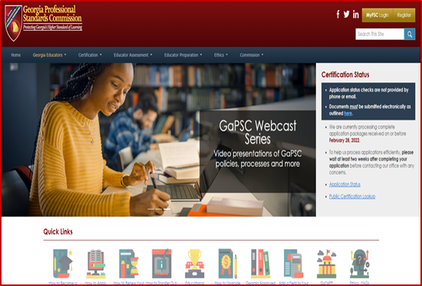
Resources
The Georgia Code of Ethics for Educators (505-6-.01)
The Georgia Code of Ethics for Educators PowerPoint (2024-2025)
Suggested Guidelines for Ethical Use of Social Media and Ethical Remote Learning
GaPSC Webinar Series
  Ethics Reporting Process and New Documentation
  Ensuring Effective Ethics Investigations
  Hot Topics: Social Media, Part 1 & 2
Available at: https://www.gapsc.com/Ethics/Ethics_Resources.aspx

Slide 107
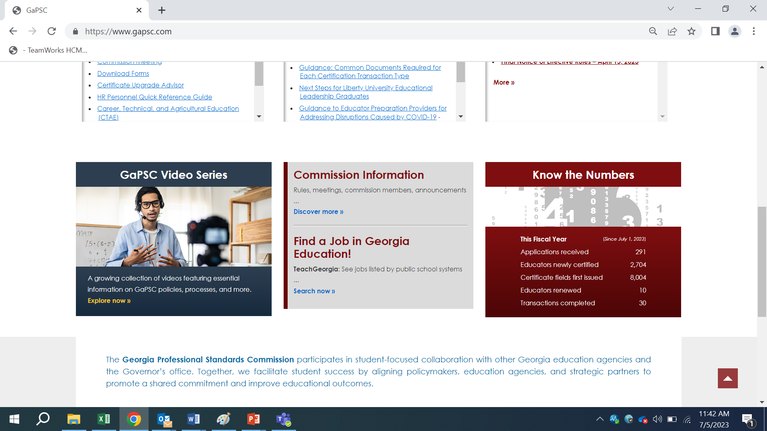
GaPSC Video Series
Available Now at www.gapsc.com
Instructional videos are currently posted, focusing on:
    Personal Affirmation Questions (PAQs)
    Code of Ethics Standards 1-5
    About MyPSC (registering, resetting passwords, changing names, checking applications)
Additional videos coming soon!

Slide 108

Contact Information
The GaPSC’s website is an important source of information.
www.gapsc.com
If additional assistance is needed, contact information is available at www.gapsc.com/ethics/contact

