Slide 1
RELATIONSHIPS
Teaching and Learning is STILL a Person to Person Transaction.

Slide 2
REASSURANCE
Kids Will STILL Need Help Coping with Nervousness and Fear.

Slide 3
RELEVANCE
Students Will STILL Wonder “Why Do I Have To Know This?”

Slide 4
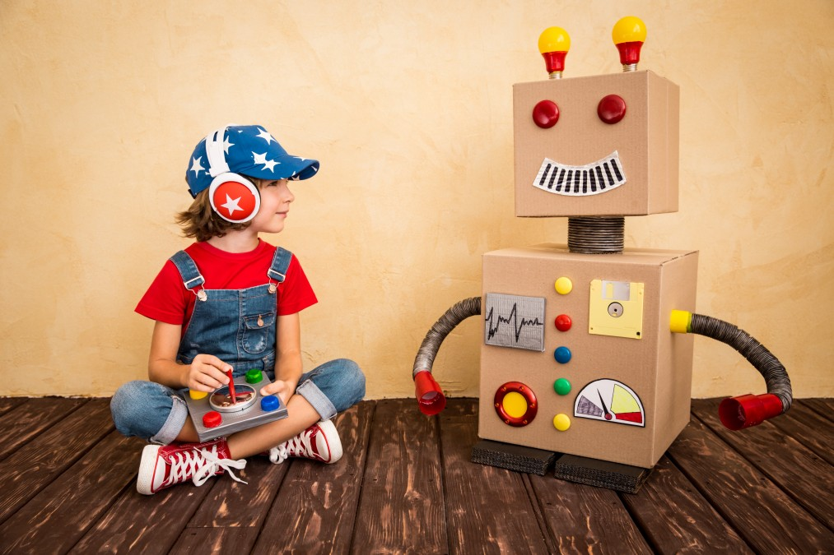
RIGOR
The Time is STILL Right to Push Them.

Slide 5
RISK
It is STILL Okay to Try New Things.

Slide 6
RESILIENCE
You STILL Have to Be Tough When Things Don’t Work The First Time.

Slide 7
REACH OUT
You Can’t Do This Alone. You STILL Need Help.

Slide 8
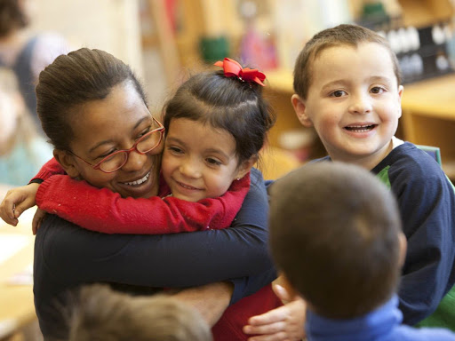
RIGHTEOUS
You Can STILL Be a Champion For Your Students.

