Slide 1
Fall West P-20 Collaborative
October 6, 2022
4pm

Slide 2
Agenda
Welcome/Introduction - Karen Wild
Georgia Certification Induction Pilot - Sabrina Collins and Jim McMickin
Changing the Narrative: A Conversation - Gretta Milam
Brainstorming
Share-outs/Next Steps
Closing Comments - Sabrina Collins

Slide 3
Certified Induction Pilot
Teacher Induction Certification Rubric
Seven Components for Certification
Roles and Responsibilities
Leadership and Organizational Structures
Mentoring
Orientation
Ongoing Performance Assessment
Professional Learning
Program Evaluation
11 Action Team Districts
27 Advisory Team Districts

Slide 4
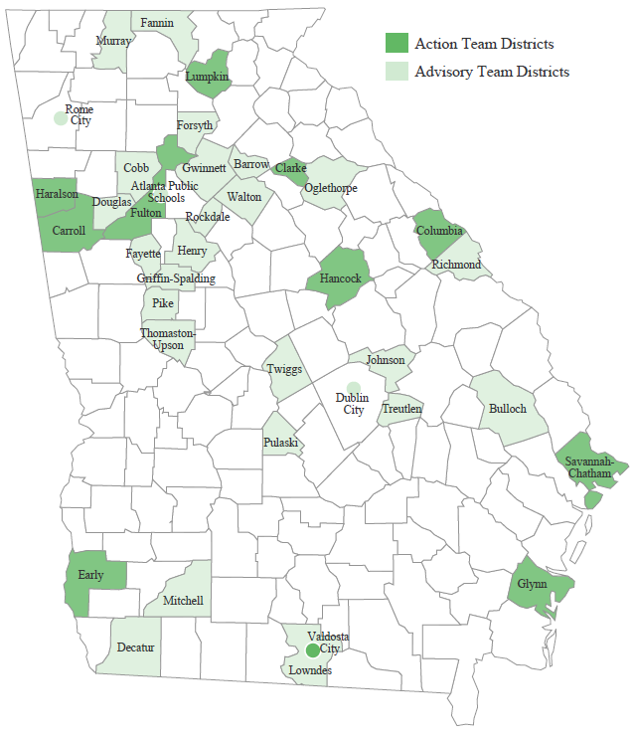
Current Pilot (38 Districts)

Slide 5
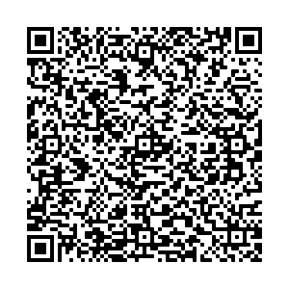
Contacts:
Jim McMickin
Leader Induction Specialist
Division of Teacher and Leader Support and Development
Email: james.mcmickin@doe.k12.ga.us
Heather Bilton
Teacher Induction Specialist
Division of Teacher and Leader Support and Development
Email: Heather.bilton@doe.k12.ga.us

Slide 6
Changing the Narrative: A Conversation
www.teacherstories.org
The teacher shortage in Georgia is no longer a future event…
Colleges and Universities need teacher candidates…
School systems need a pool of qualified applicants to fill open positions…
How can we change the narrative from, “Why would you want to be a teacher?” to “I’m so glad you’re going to teach!”
How can we change the narrative from, “I can’t do this anymore!” to “I can’t wait to see my students tomorrow!”

Slide 7
State Education Agency Updates
P-20
Watch for the Follow-up Email!

Slide 8
Georgia Professional Standards Commission
Certification and Program Officials Conference is November 3 and 4!
Find guidance related to HB1084 (Protect Students First Act) here: https://www.gapsc.com/EducatorPreparation/Resources/Downloads/IHE/Protect_Students_First_Act_Guidance_July2022.pdf
The following Educator Preparation rules are being revised based on recent Task Force work:
Special Education
English Education
CTAE
Financial Literacy
Middle Grades

Slide 9
Georgia Department of Education
Teacher Induction Certification Pilot - a representation of 40+ districts are serving as critical partners in two tiers of involvement
Development of the rubric to be used to indicate progress toward exemplary induction program at the district level • Determination of the indicators for the rubric anchor points
Leader retention support - partnership with SREB to develop a community of practice and professional learning for leaders in districts with retention needs in the leadership position
Educator pipeline dashboards - continual release of additional data sets and additional filtering capability within the data sets
Educator wellness sessions - providing regional professional learning sessions to focus on best practices to support educator wellness
Grant support - ongoing support to districts, RESAs and EPPs who are recipients of Teacher leader, Teacher endorsement and/or GaTAPP grants
Grow your own toolkit - development and distribution of a toolkit for districts and schools to use to generate student interest in the education profession
TKES/LKES support - revision of the Interrater Reliability training (Evaluation System Specialists will provide on-site sessions by request as available)
Additionally, work is ongoing with the Teacher Tax Credit Program and the Teacher Evaluation Pilot (application period opened September 1)

Slide 10
Governor’s Office of Student Achievement
Georgia K-12 Teacher and Leader Workforce Report is available: https://gosa.georgia.gov/georgia-k-12-teacher-and-leader-workforce-report
The 2022 - 2023 Governor’s School Leadership Academy is underway with over 400 educators engaging with the programs, representing over 60 districts. For information about GSLA, please visit: https://gosa.georgia.gov/governors-school-leadership-academy.
The 2022 - 2023 Growing Readers program is underway. Visit https://gosa.georgia.gov/programs-initiatives/growing-readers to learn more about the program.
Georgia Educator News from GOSA is available here: https://gosa.georgia.gov/pressreleases/2022-06-29/ga-education-news-gosa-june or view the entire newsletter online here: https://mailchi.mp/gosa/junenews2022. The June edition featured Muscogee County Schools in the District Spotlight to highlight their partnership with GSLA to support Teacher Leaders in their district.

Slide 11
University System of Georgia
USG will extend test optional admissions for Academic Year 2023-2024 for 24 of the 26 Georgia institutions.
USG has a new data tool: Georgia Degrees Pay. https://www.usg.edu/georgia-degrees-pay. The tool compares student success and affordability of all 26 public colleges and universities in Georgia.
eCore offers online general education courses taught by instructors from USG institutions and are transferable within the USG, as well as most regionally accredited schools. If you know a paraprofessional who does not yet have a bachelor’s degree, these courses may be very helpful to them as they seek certification.

Slide 12
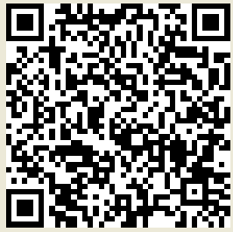
Fall 2022 P-20 Collaborative Survey
https://www.surveymonkey.com/r/P20Fall2022

