Slide 1
Bridging the Gap Between Educational Policy, School Culture, and Wellbeing
Dr. Kelsey Evans-Amalu,
The Mindful Prof, LLC

Slide 2
The State of Education
According to a 2022 Gallup Poll, more than four in 10 K-12 workers in the U.S. (44%) say they "always" or "very often" feel burned out at work, outpacing all other industries nationally. College and university workers have the next-highest burnout level, at 35%, making educators among the most burned-out groups in the U.S. workforce.
Typically, 8 percent of teachers leave the profession every year. However, the National Education Association surveyed about 3,600 of its members in January of 2022 and found that 55 percent of respondents said they are more likely to leave or retire from education sooner than planned because of the pandemic.

Slide 3
COVID-19 and It’s Impact
According to Robinson et al. (2022), research suggests that during the pandemic academic years, teachers experienced stressors related to their personal and professional roles, concerns for students’ well-being which extended beyond academics, and frustrations with administration and other institutional entities around COVID safety measures.
→Without adequate support and inclusion of teacher perspectives, job-related stress may lead to teacher shortages, deterioration of teacher mental health, and ultimately worse outcomes for students.
****Within this presentation, suggestions for policy, research, and practice are discussed.

Slide 4
Defining Wellbeing
How do you personally define wellbeing?

Slide 5
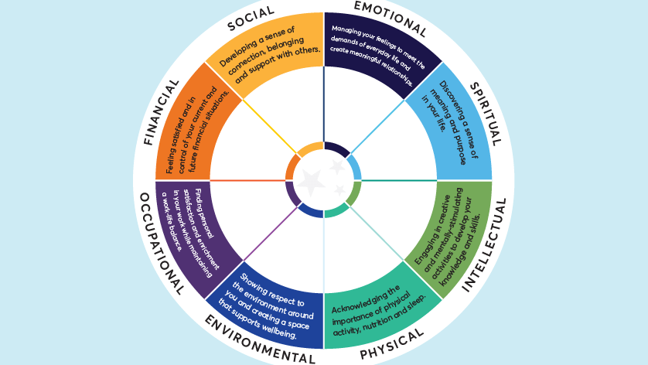

Slide 6
Wheel of Wellness Worksheet
We will take a few moments to interact with a worksheet on the wheel of wellness. Personally examining where you are at on the wheel.
I will be sending the pdf via the chat box, but will also be sharing on the screen.
You may also complete this on your own time.

Slide 7
Teacher Wellbeing
Educator burnout has increased in the United States over the past decade (Wang et al., 2015; Koenig et al., 2017), and it has been attributed to chronic strain that results from the mismatch between job demands and available resources to emotionally and mentally cope with the job demands (Lauermann & Konig, 2016). And over the last 40 years, teacher attrition rates in North America have increased from 30% to 40% (Wang et al., 2015).
Yet wellness has not been systematically explored within the field of education (Sackney et al., 2000), and teachers are often unaware of the few outlets that exist to explore their personal and emotional needs, such as counseling services, physical wellness memberships, and social support groups (Taxer & Frenzel, 2015). Clearly, there is a need for more emphasis on educators’ well-being.
If educators are focused on supporting the whole child, including social and emotional health, why aren’t we supporting the wellness of the whole educator? And what can we do about that?

Slide 8
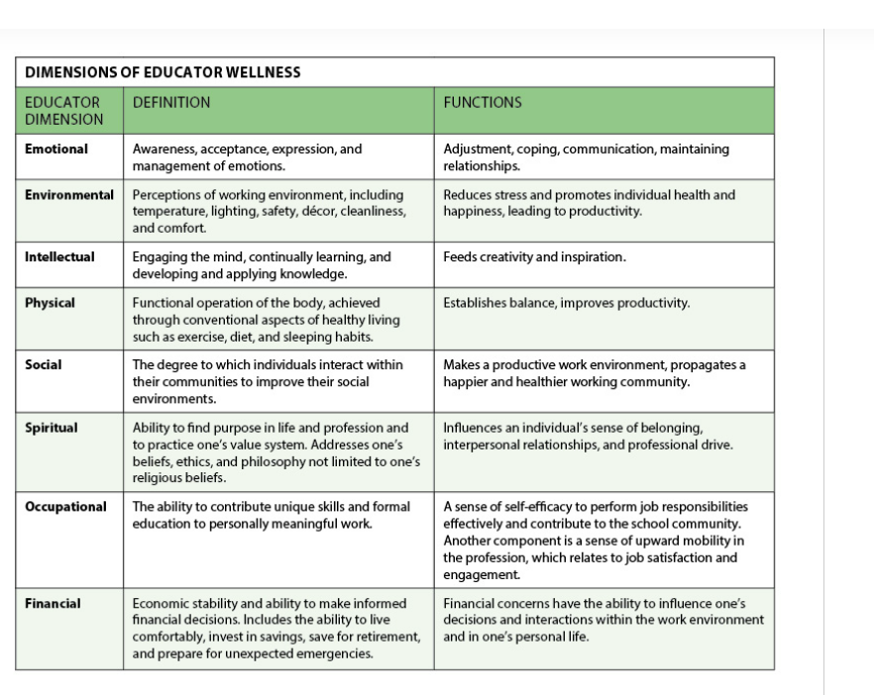
Dimensions of Educator Wellness

Slide 9
Emotional Wellness
Educators can achieve emotional management and wellness through individual activities that allow for self-reflection and processing as well as maintaining connections with friends who are active listeners, trusted colleagues, mentors, coaches, or professionals who are trained in emotional wellness strategies.
Individual activities help, too — practicing mindfulness or meditation, partaking in a hobby, taking a leisurely walk in nature (Zurawik, 2020), or using journaling techniques to process through emotions (Pennebaker, 1997).
Educators may want to consider counseling when self-care techniques aren’t enough. Counseling gives the educator a safe space with a neutral party to make sense of emotions and gain clarity in how to make necessary life adjustments.

Slide 10
Environmental Wellness
Because environmental wellness establishes the physical and mental foundation that grounds an educator’s work, administrators and systems must create and maintain environments that minimize stress for teachers and students and support overall wellness. School districts and school administrators need an environmental climate policy that supports teachers’ environmental wellness by providing maintained and controlled climates, including lighting, temperature, cleanliness, and access to immediate room repairs.
In our experience, even painting walls has positively influenced teachers and students’ moods and willingness to keep the environment cleaner.
***Ex: The Namaste Project’s Zen Den

Slide 11
Intellectual Wellness
The pursuit of one’s intellectual passion is essential for educators’ relational and instructional engagement with students. It helps them stay current with evolving research and follow through with emerging best practices.
Schools are responsible for — and ultimately benefit from — cultivating an environment that helps employees pursue creativity and knowledge. Education systems need to provide educators with opportunities to continually expand their content knowledge and pedagogical practices, particularly in how to serve students in culturally responsive and equitable ways. High-quality professional learning is essential for nurturing intellectual well-being.

Slide 12
Physical Wellness
Educators often feel so extended by the day-to-day demands of their professional and personal lives that they don’t make time for physical wellness. Educators who have a depleted sense of physical wellness are more susceptible to physical and mental illness, which has a direct influence on attendance, relationships, and capacity to serve students. In turn, this can have a negative impact on other educators and their ability to serve students.
School districts can support physical wellness by providing discounted gym memberships, access to school gyms with designated hours for educators to use district equipment, group exercise classes, or physical wellness challenges.

Slide 13
Social Wellness
Social wellness provides the foundation for interaction and participation with and commitment to students, parents, and the community that are rooted in mutual respect, interdependence, and cooperation (Sackney et al., 2000; Strout & Howard, 2012).
Educators must engage in opportunities that allow them to interact and socialize with other individuals outside of the workplace to meet their social wellness needs. Schedules filled with evening athletic events, school community events, professional learning, and lesson planning can interfere with educators creating a healthy work-life balance.

Slide 14
Spiritual Wellness
Spiritual wellness allows educators to find their purpose and passion within the profession, enabling them to serve students equitably. Spiritual wellness is unique to each individual in how he or she will cultivate the understanding to support this dimension. Educators can create the space for deepening their spiritual wellness by examining individual aspirations, looking for deeper meanings, and analyzing recurring patterns through reflective journaling, meditation, self-help book studies, and introspective mindfulness time.

Slide 15
Occupational Wellness
Schools have a moral obligation to build educator capacity and to retain and value each educator as a contributing member of the collective school district. Educators’ occupational wellness is often threatened because of limited growth opportunities. For example, many educators believe that the only path for career advancement is administration — a pathway that doesn’t appeal to everyone.
Education systems must make clear to educators that there are many ways to contribute to the school and the field. A district’s professional learning or human resources department could provide seminars on possible advanced pathways by partnering with a local university to share training that is available for school instructional deans, school counselors, school psychologists, district office coordinators, and directors in areas such as curriculum, research and assessment, educational technology, and professional learning.

Slide 16
Financial Wellness
Financial wellness has a direct effect on educators’ ability to support their life, health, and mental well-being. If an individual is under financial stress, this occupies an overwhelming amount of an individual’s mental capacity, preventing educators from being fully mindful and critically conscious in their instructional practices and relationships.

Slide 17
Interconnections
In our experience, this involves a blend of small and larger structural steps that education systems can take. For example, looking at financial wellness, a small step is shifting the payment schedule from 10 months to 12 months, making it easier to budget monthly expenses and plan for unexpected life situations on small salaries. Larger, more structural solutions include increasing teachers’ salaries and partnering with municipalities to provide affordable housing options. The latter is an example of an approach that addresses multiple wellness domains, including environmental and perhaps physical in addition to financial.
To support students equitably, we must support educators in a range of ways, large and small, so that they can achieve all eight dimensions of wellness. We are past due in attending to educator wellness, and every step counts.

Slide 18
How are/is you/your school currently contributing to create school culture built on the wheel of wellness?

Slide 19
At the Crossroads of Wellness, School Culture, and Policy
To achieve wellness goals, effective implementation is required. Schools have different strengths, starting points and contexts — there is no one-size-fits-all model for school improvement.
To sustain and accelerate improvement, schools need to identify the right evidence-based improvement strategies, plan for effective implementation, and translate these strategies into the day-to-day work of staff.

Slide 20
The Importance of Policy
While state policymakers have been working to improve student mental health for years, there has not been much legislative action related to teacher mental health. It is, however, an issue that warrants attention from policymakers.
Supporting teachers’ mental health is one way to show true appreciation for our teachers and can have positive impacts on teacher retention and student achievement.
On the following slides are examples of three policy options for state leaders to support teacher mental health

Slide 21
Secondary Traumatic Stress
Address Secondary Trauma in the Workplace. This direct approach to support teacher mental health is not yet common in state legislation. So far in 2021, there has only been one bill enacted that directly addresses this issue. Washington House Bill 1363 focuses on secondary trauma — or compassion fatigue — in the educator workforce by requiring states and districts to develop educational resources, policies and procedures to prevent and address secondary traumatic stress.

Slide 22
Support Teacher Mentorship
Support Teacher Mentorship. Teacher mentorship programs can foster a more supportive school environment, which research shows may reduce teacher stress. Providing teachers with support from a colleague in their early career is crucial to their ongoing success in the classroom.
As of 2019, 31 states require induction and/or mentoring support for new teachers, though research shows that high-quality, comprehensive programs must incorporate a variety of components, such as appropriate timing and length, setting high standards and mentor criteria/training. There are several state and local examples of these types of programs, including North Carolina’s Beginning Teacher Support Program, which is a required three-year induction program for beginning teachers that provides mentor teachers with protected time to support beginning teachers and enable their success.
In 2022, there are three higher education institutions in Georgia that offers the mentorship program named Call Me MISTER, an acronym that stands for Mentors Instructing Students Toward Effective Role Models.

Slide 23
Implement Planning Time and Reduced Work Hours
Implement Planning Time and Reduced Work Hours: Because research also demonstrates that job demands are a source of teacher stress, providing teachers with more planning time or reducing work hours may also improve teacher mental health. According to ECS’ 50-State Comparison on Teacher Recruitment and Retention, as of 2019, only 11 states required an established portion of a teacher’s workday to be designated for planning.
Virginia, for example, requires at least an average of 30 minutes per day during the school week as planning time for elementary school teachers and one planning period per day for middle school and high school teachers. Some states, like Indiana, have introduced legislation this year to require planning time. Indiana Senate Bill 57 would require governing bodies and administrators to provide 30 consecutive minutes for teacher preparation time that’s free of any other assigned responsibilities.
While there has not been much legislative action in states to reduce work hours, this approach may also help reduce teacher stress and improve mental health. South Carolina introduced House Bill 3004 this year, which would prohibit teachers from being required to work more than 37 1/2 hours each week without overtime pay.

Slide 24
Now What?
Cultural change, although challenging and time-consuming, is not only possible but necessary.
How do you change the culture of schools? When it comes to lasting cultural change, four essentials are consistent across many leadership contexts.
First, define what you will not change. Identify specific values, traditions, and relationships that you will preserve.
Second, recognize the importance of actions. Speeches and announcements are not enough. To lead challenging reform efforts, you must be willing to make personal changes in decision-making policies (Who has the authority to decide what?); personal time allocation (Which meeting invitations do you accept and which do you decline?); and collegial relationships (Do you make time to listen to the personal stories of your colleagues?).
Third, use the right change tools for your school or district.
Fourth, be willing to go through the weeds.

