Slide 1
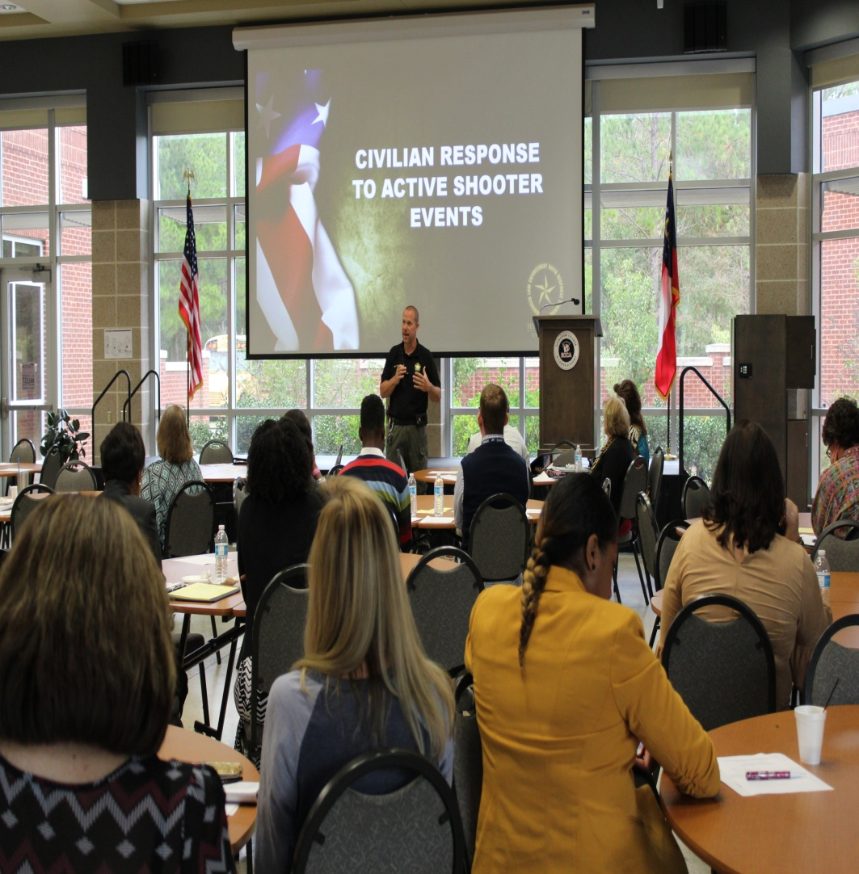
Southeast P-20 Fall Convening October 23, 2018 Effingham College and Career Academy
Agenda Included:
Trauma Informed Practice
Dr. Amee Akins: Department Head, Middle Grades and Secondary Education, Georgia Southern University, Armstrong Campus
Dr. Regina Rahimi: Professor, Middle Grade and Secondary Education,
Georgia Southern University, Armstrong Campus
School Safety and Active Shooter Protocols Officer Dan Mealor
School Climate Irene Denmark,
First District RESA

