Slide 1
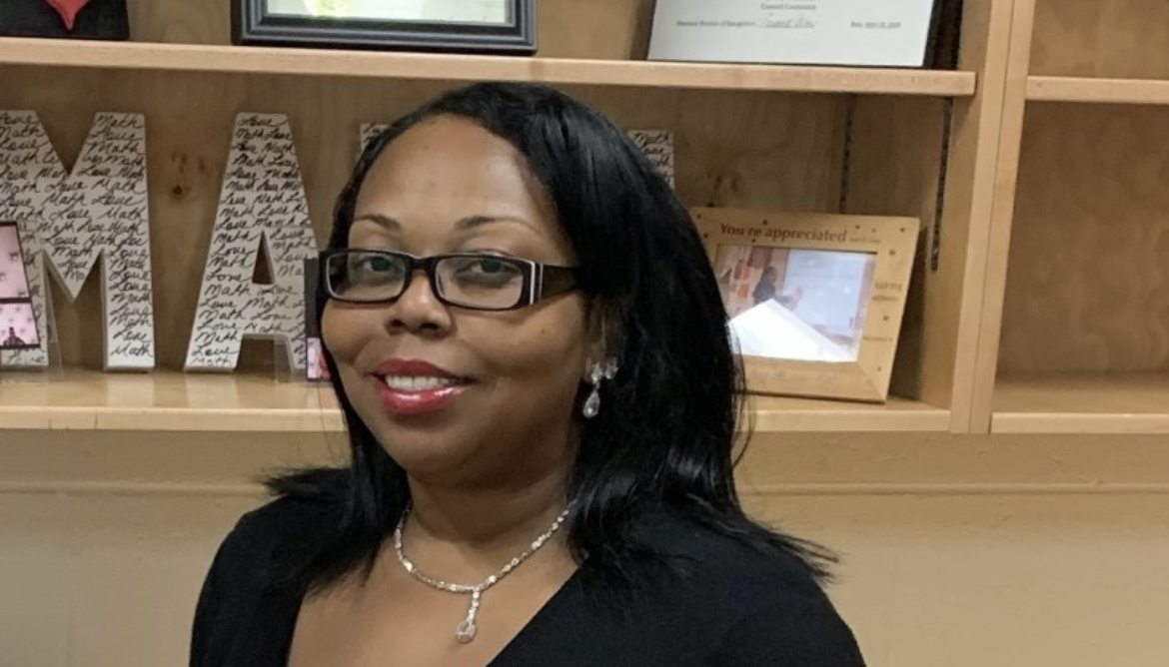
2022 Georgia Association of Colleges for Teacher Education Mentor Teacher Recognition
Ms. Erica O'Neal, Henry County Schools
Ms. O’Neal has served as a mentor teacher for more than 5 years including her service as a master teacher to interns participating in the Intern to Teacher program in Henry County Schools. She works tirelessly to support teacher candidates and freely shares her educational expertise and advice. She is an exemplary mentor who sets high standards and assists her candidates in achieving success.
Ms. O’Neal’s passion for the teaching profession is evident in both her words and actions. She is a consummate professional and is a valued member of the Clayton State University Clinical Educator Professional Learning Community. She is a strong advocate for aspiring teachers and serves as Math department chair and tennis coach at Hampton High School.

