Slide 1

Educator Preparation:
Transforming the Profession
Educator Preparation Staff
Friday, December 13, 2013
12:00 – 2:30
Notes:
1

Slide 2

Presenters
Penney McRoy, Assistant Division Director
Cyndy Stephens, Program Director, Educator Workforce Human Resources Acquisition and Development
Angie Gant, Program Director, Program Approval
Julie Beck, Education Specialist, Race To The Top
Anne Marie Fenton, Program Director, Educator Testing and Title IIA
Phyllis Payne, Program Director, Non-Traditional Preparation

Slide 3

Topics
Introduction and overview
School Staffing Data
Preparation Program Reforms
Educator Testing Reforms
Non-traditional Preparation
Connecting the Dots

Slide 4
Introduction
Penney McRoy
Notes:
4

Slide 5
Resources
Laptop
Ed Prep folder
  PowerPoint Presentation
  Commission Retreat Graphic Organizer
  10 Recommended Policy Actions from Our Responsibility Our Promise (CCSSO Report)
  Definitions of Learner Ready Teacher and School Ready Principal
  edTPA School Flyer
  edTPA Video
  Draft Outline of Educator Ethics Modules

Slide 6
Resources
Folder Contents
Commission Retreat Graphic Organizer with a Bingo Card attached
10 Recommended Policy Actions from Our Responsibility Our Promise (CCSSO Report)
Definitions of Learner Ready Teacher and School Ready Principal
Certified Personnel Vacancies by RESA
Certified Personnel Vacancies by Field
edTPA School Flyer and Overview
Draft Outline of Educator Ethics Modules
Clayton County Public Schools GaTAPP Data
Alignment of Danielson’s Framework for Teaching, edTPA Rubrics & TAPS Standards to the InTASC Standards
Notes:
Use the Graphic Organizer to record notes and questions; or use the electronic version

Slide 7
Bingo
Materials:
Skittles
Bingo Card -- terms and acronyms
Process:
As you hear a term place a skittle on that spot
Yell Bingo! when you fill a row
The first four people to yell Bingo will receive a prize

Slide 8

Framing Questions
Posted on each side wall
Use your graphic organizer or other paper to jot down your responses to these questions as they emerge

Slide 9
Theme
Improving student achievement through the transformation of educator preparation and entry into the profession

Slide 10

Ideals
Ten recommendations of the CCSSO
Learner Ready Teachers
School Ready Principals
These ideals provide us with a roadmap…

Slide 11

Notes:
Sometimes it looks like this…

Slide 12
Translating Ideals into Practice
Think of Educator Preparation as a continuum…
  beginning with recruitment…
  continuing into a preparation program…
  moving from a program into induction…
  and
  continuing throughout a career

Slide 13
The Work
The work of the GaPSC Educator Prep Programs and other agency efforts represent points along this continuum.
Educator Workforce Human Resources Acquisition and Development
Educator Testing and Title IIA
Non-traditional Preparation
Program Approval

Slide 14
School Staffing Data
Cyndy Stephens
Notes:
14

Slide 15
Instructional Capital Planner (ICP)
ICP is an educator workforce information and planning tool for school districts, preparation programs and state education agencies to view:
All current core content teachers’ building, level and teaching assignments, certification, HiQ, attrition risk factor
Teacher Supply Pool
Notes:
-- real-time
-- Adding content areas, CTAE, other fields

Slide 16
GS3
Georgia School Staffing Survey (GS3)
All school districts are to:
Report complete, true and accurate vacancies by teaching position and field
Transmit data to PSC on a semi-annual schedule
GS3 collection and reporting is authorized in requirements of HB283, effective July 1, 2013.
Notes:
certified personnel

Slide 17
Vacancy Data: Impact on Students
81 of 183 districts - no vacancies
  State and charter schools not in Fall ‘13 count
1,675.79 teacher vacancies statewide
  Estimated 53,261 students unserved for all or part of school day in 4 content areas/consultant fields…
Notes:
October 14, 2013, Report

Slide 18
Highest Vacancies
Top 4:
Early Childhood – 21,652 students unserved
      Metro, Chat-Flint and Coastal Plains RESAs
Special Education – 10,238.2 students unserved
          P-12 Special Ed. Content – Science, Language Arts, Math, Reading, Social Sciences -- 4,183.8
      P-12 General Curriculum, LD, BD, Adaptive, Pre-K -- 6,049

Slide 19
Highest Vacancies
    3. Math 13,136 students unserved
    Grades 6 - 12 -- 9,330
    Grades 4 - 6 -- 3,806
    4. Science 8,235 students unserved
  Grades 6 -12 -- 5,074
    Grades 4 – 8 -- 3,161
  Expectations for use of the data…

Slide 20
Program Reforms
Angie Gant
Notes:
20

Slide 21
CAEP
With a partner, answer these questions:
  What does this acronym stand for?
  What two entities united to form CAEP?
  What is its role in Georgia?
How did you do?
  Council for the Accreditation of Educator Preparation
  NCATE and TEAC consolidated
Notes:
In two minutes

Slide 22

CAEP’s Role
CAEP advances excellence in educator preparation through evidence-based accreditation that assures quality and supports continuous improvement to strengthen P-12 student learning.
http://caepnet.files.wordpress.com/2013/09/final_board_approved1.pdf

Slide 23
Standards
NCATE
Candidate Knowledge, Skills, and Dispositions
Assessment System
Field Experience and Clinical Practice
Diversity
Faculty Qualifications
Unit Governance
CAEP
Content/Pedagogical Knowledge
Clinical Partnerships and Practice
Candidate Quality, Recruitment, and Selectivity
Program Impact
Continuous Improvement

Slide 24
Partnerships
Blue Ribbon Panel Report (2010): “All teacher preparation programs and districts have to start thinking about teacher preparation as a responsibility they share, working together.”
http://www.ncate.org/LinkClick.aspx?fileticket=zzeiB1OoqPk%3d&tabid=715

Slide 25
Student Teaching
Then and now
What is co-teaching?
  At its best, student teachers and cooperating teachers plan, instruct, and assess students together.
Some of the models
Research shows

Slide 26

PPEMs
Standards
Standards
PPEMs

Slide 27
Testing Reforms
Julie Beck and Anne Marie Fenton
Notes:
27

Slide 28

The Next Step in Transforming
Educator Preparation

Slide 29
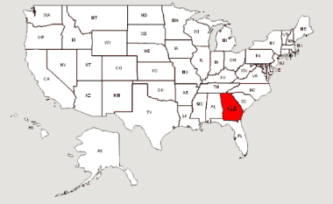
Georgia Wants
Beginning teachers who are ready to teach
To accelerate the time it takes for new teachers to become effective
To lower the frustration level of our beginning teachers

Slide 30
Consequential Fall 2015
Induction Certificate
Teacher Induction
Program Accountability
Educator Preparation Program Improvement

Slide 31
Who am I teaching?
What am I teaching?
How will I know if the students understand?
How will I teach it?

Slide 32
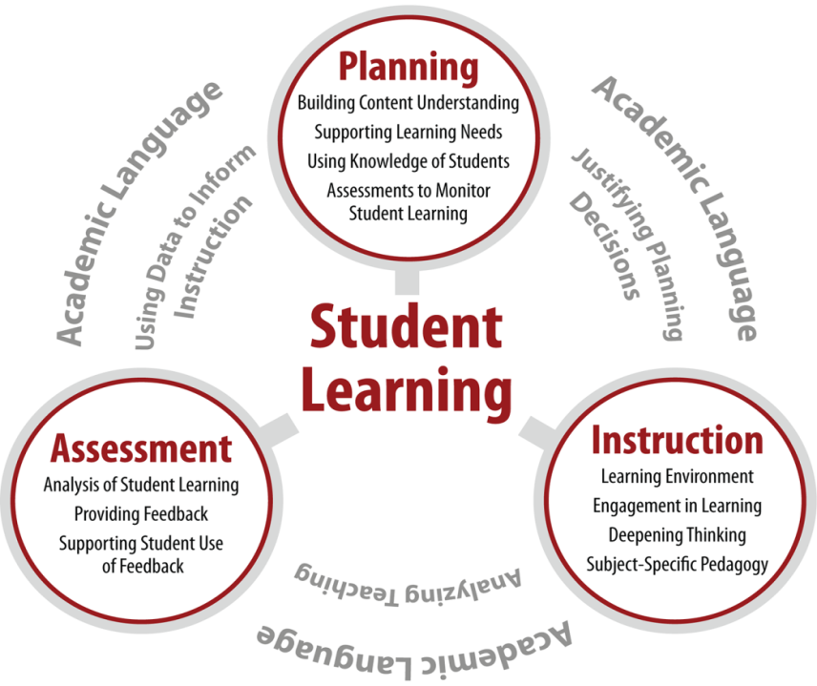
edTPA
With retirements growing, Georgia will need new teachers….
Teachers ready on Day 1 to help students in Georgia prepare for the future.

Slide 33
Educator Ethics Assessment
State Policy Changes
  505-3.01
  Tiered Certification
Opportunity and Need
Eliminating Silos

Slide 34
Approaches
“The Professional Educator”
  Like other professions, with special values, rules, duties, and public responsibilities
  All of which have to be balanced
  All of which have to be learned and practiced

Slide 35
Approaches
Tone: Peer-to-peer, professional-to-professional
  NOT lecture, superior-to-underling
High attention to engagement
  Use video scenarios, storytelling
  Favor shorter modules
Asynchronous, well planned sequence of experiences that establish knowledge, elevate behavior, and encourage ethical actions and decisions
Notes:
Positive modeling

Slide 36
Collaborative Development
Educator Ethics Advisory Committee
Focus Groups
Teacher and Leader Module Courseware Development
Piloting

Slide 37
Non-traditional
Educator Preparation
Phyllis Payne
Notes:
37

Slide 38
Candidate Support Team Model
Characteristics:
  School-based administrator and mentor, Provider Supervisor, Content Specialist
  Trained in coaching skills and the work
  Meet three times a year and as needed based on candidate performance data
Strengths
  On-going individualized support during job-embedded practice
  Identify critical needs quickly and provide support

Slide 39
Enrollment/Retention Data
Enrollment:
*1/2 year
Retention Rates:
  84% to 86% 3 years after completion
  Several EPPs report 96% - 98% retention rates
Frequently GaTAPP candidates are employed in their home communities.
Academic Year | Newly Enrolled | Total Enrolled
2013-2014 | 556* | 1432*
2012-2013 | 664 | 1513
2011-2012 | 585 | 1386

Slide 40
Provider Performance Data
Clayton County:
  Completion/Retention Data
  Standardized Tests: Middle School, ECE CRCT
  EOCT: Literature and Math
  Comparison of GaTAPP to veteran and new teachers
CSRA: Incomplete
  Scoring above state and school level
  EOCT Biology Teacher: 68 Exceeds, 24 Met, 4 NM
Notes:
Gwinnett: Survey of Principals

Slide 41
Conclusion
Penney McRoy
Notes:
41

Slide 42

Framing Questions
Join with one or two other Commissioners
Compare your responses
Share

Slide 43

Connecting the Dots
Our intersecting and overlapping responsibilities
Partner agencies and organizations
All focused on providing the best teachers for Georgia’s classrooms
GA is well positioned to achieve the ideals set forth in Our Responsibility Our Promise
Notes:
Ask Commissioners to name partner organizations and agencies
Talk about the Alliance and the fact that no other state (that we know of) has such an organization

Slide 44

Any Remaining Questions

Slide 45

Contact Us
Julie Beck -- julie.beck@gapsc.com 404-232-2642
Anne Marie Fenton -- annemarie.fenton@gapsc.com 404-232-2654
Angie Gant -- angie.gant@gapsc.com 404-232-2655
Penney McRoy -- penney.mcroy@gapsc.com 404-232-2629
Phyllis Payne -- phyllis.payne@gapsc.com 404-232-2554
Cyndy Stephens -- cyndy.stephens@gapsc.com 404-232-2645

Slide 46
Thank You!

